Slide 1

SVC Occlusion Device Sensors
Lee Hyunwoo

Slide 2
Table of Contents
Project overview
Device actuation flow
Bend sensors
Strain gauge
Velostat sensor
Flex sensor
Barometric sensor
Discussions

Slide 3
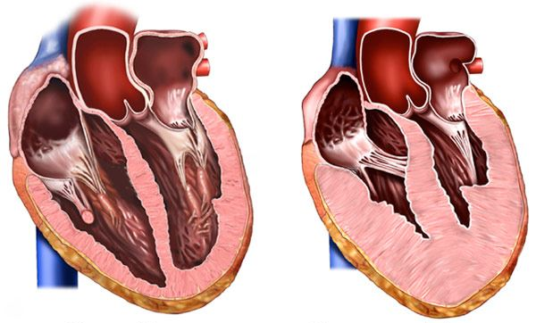
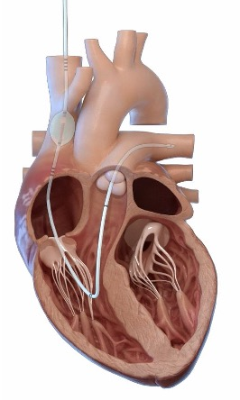

Heart failure
Temporary relief to prevent acute heart failure
Figure 1: Normal heart
Figure 2: Heart with structural alteration
Figure 3: Illustration of preCARDIA therapy

Slide 4
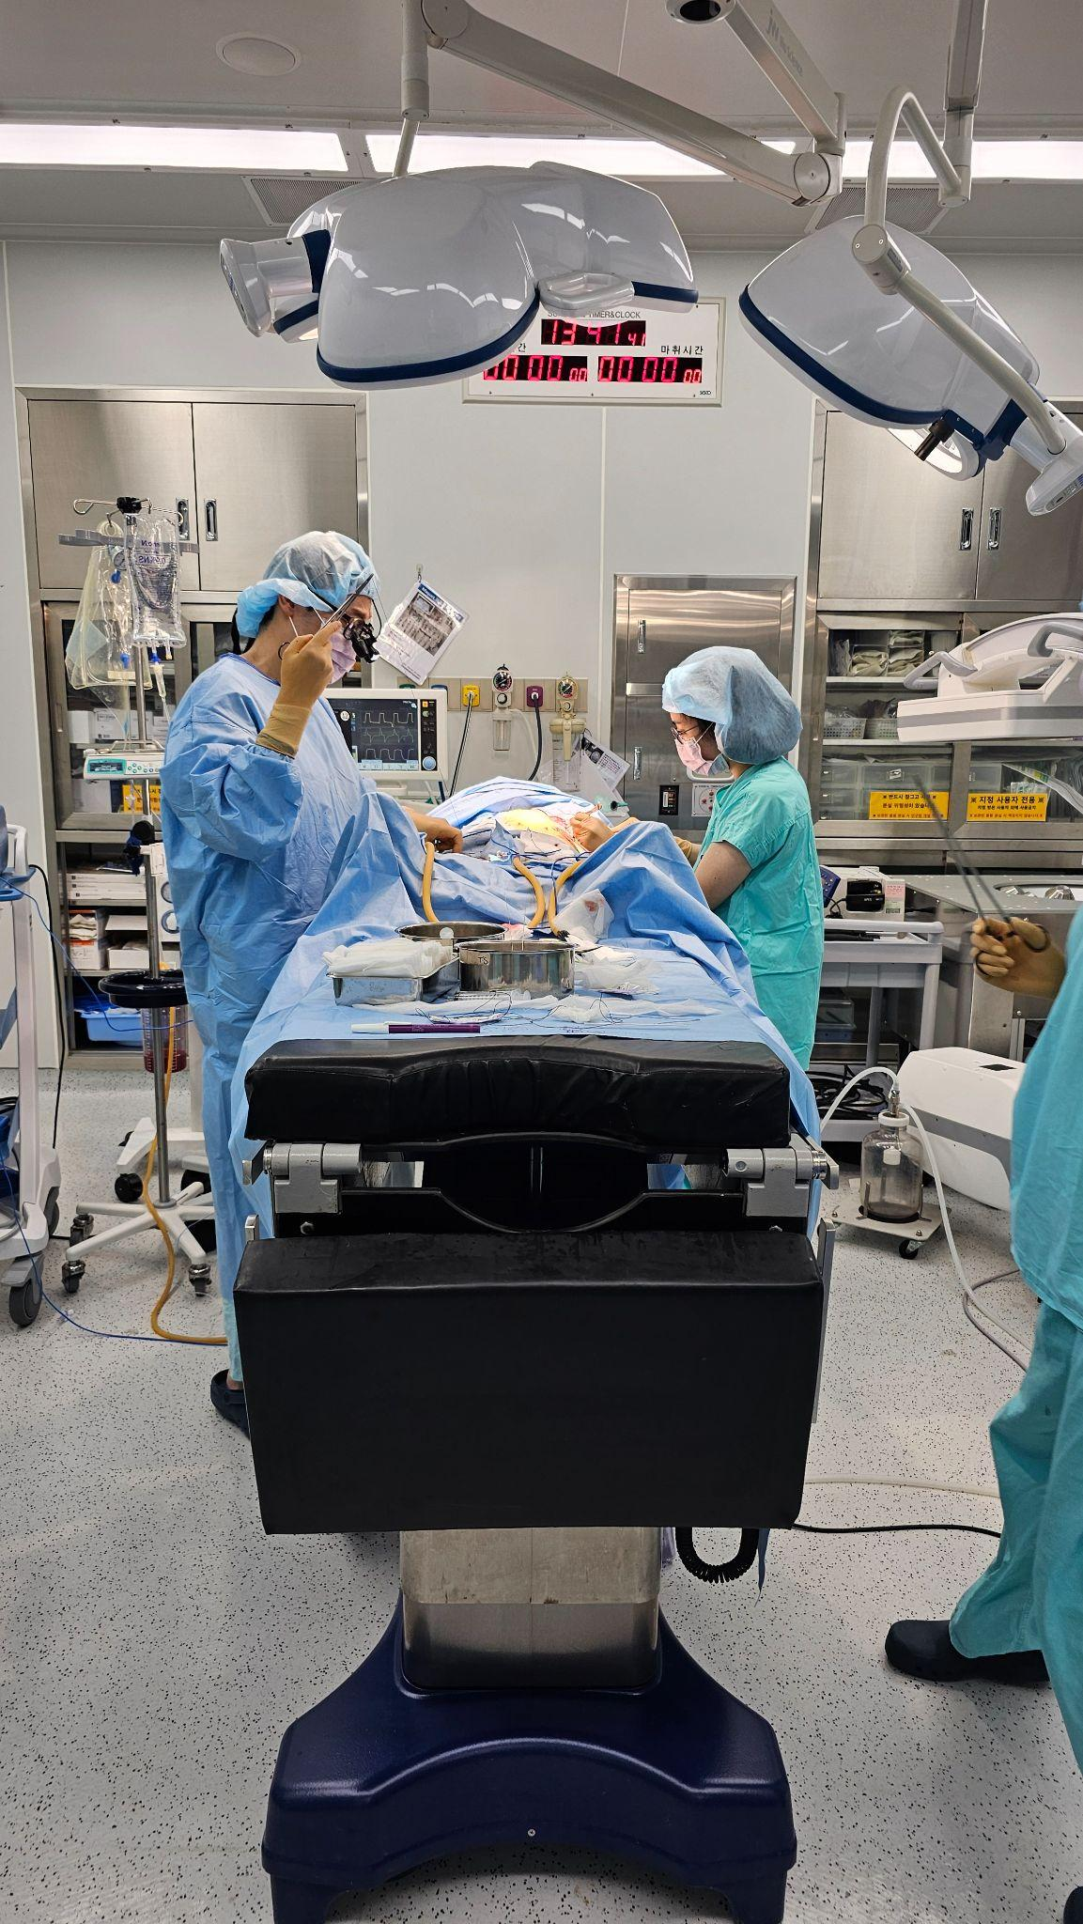
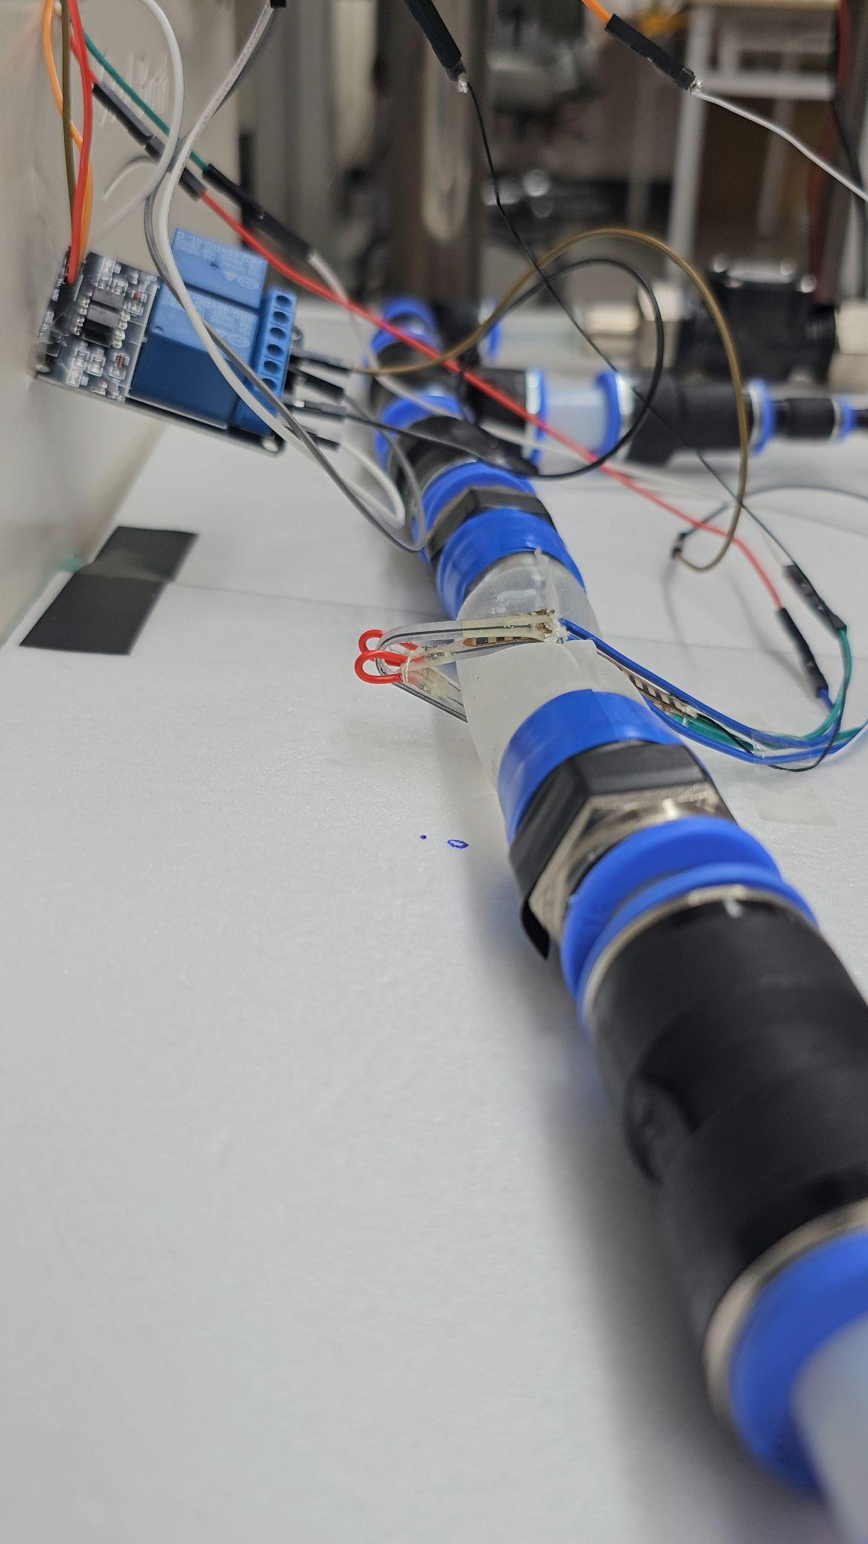
Project Overview
Animal testing: Verify that external occlusion (pinching) of SVC can yield same result as internal occlusion
Occlusion device: Occlude the SVC from exterior to a desirable percentage
+
Figure 1: Animal testing
Figure 2: Occlusion device testing on SVC phantom

Slide 5
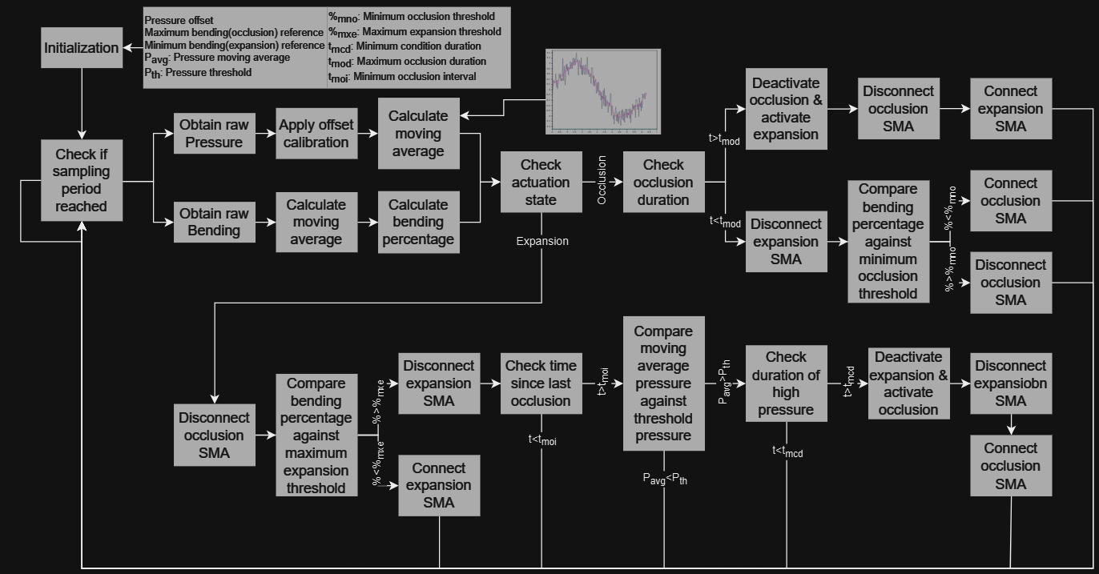

Slide 6
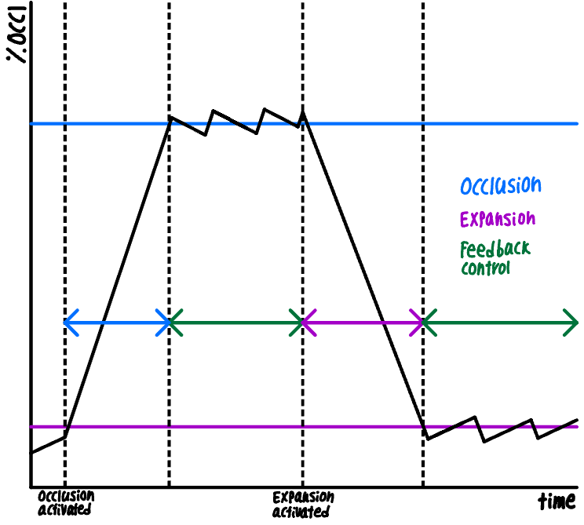

Slide 7
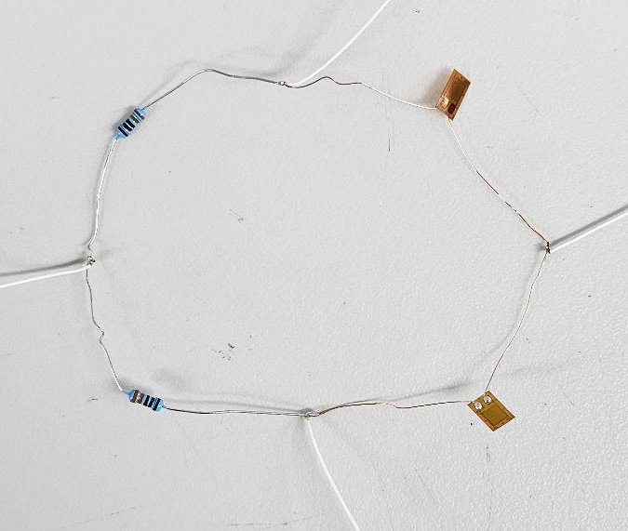
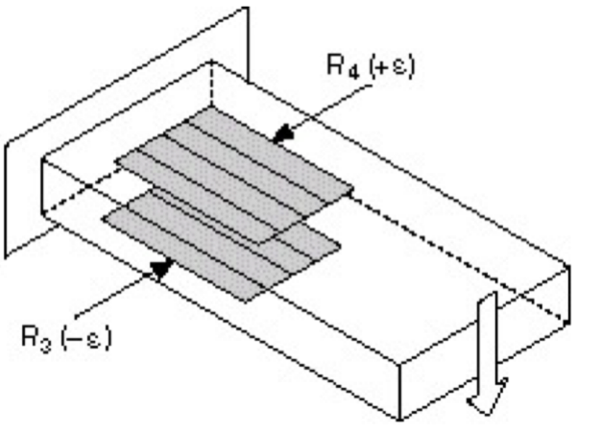
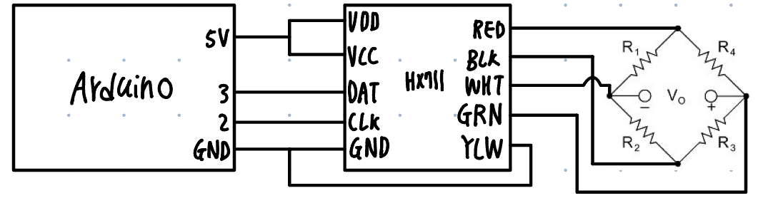
Strain Gauge
Change resistance when strain applied
Balance bridge using resistor with small errors
Minimum write length and solder to remove any unintended resistance
Figure 1: Soldered strain gauges
Figure 2: Strain gauge half bridge placement
Figure 3: Circuit connection of strain gauge

Slide 8
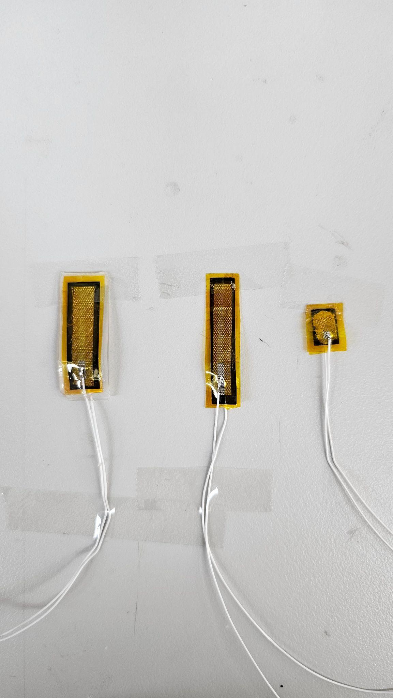
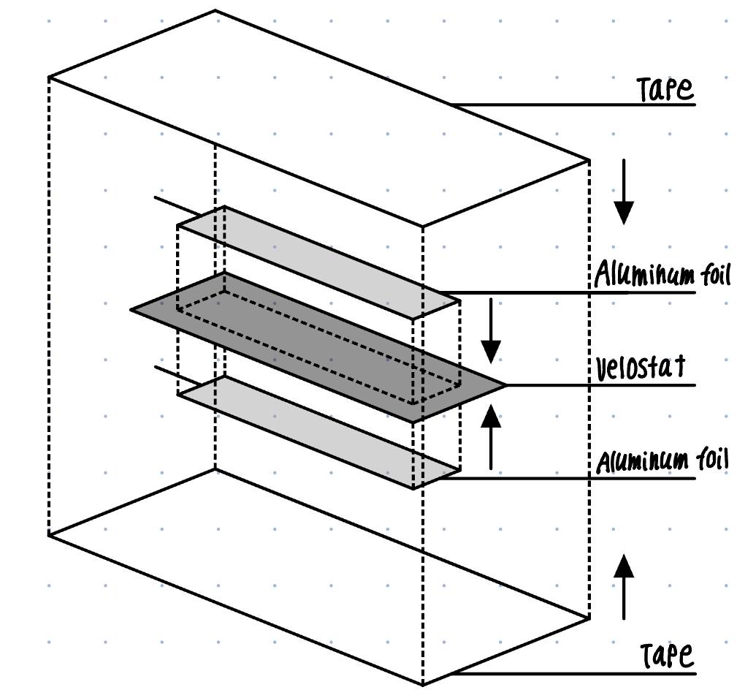
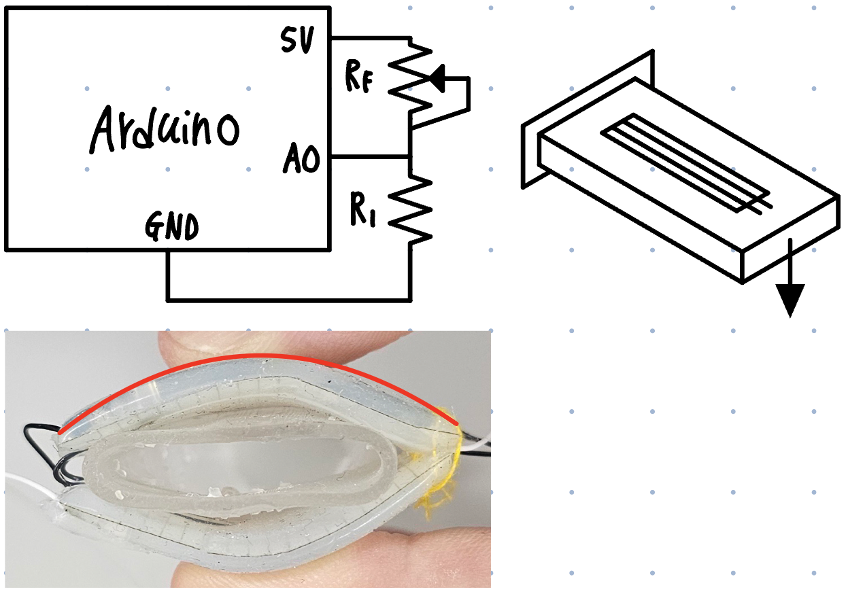
Velostat Sensor
Decrease resistance when deformed (stress is applied)
Fabrication methods attempted:
Sticking with kapton tape
Applying conducting grease
Silicon casting
Applying adhesive and applying pressure
Applying conducting proxy
Figure 2: Velostat sensors made
Figure 1: Velostat bending sensor exploded view
Figure 3: Circuit connection of velostat sensor

Slide 9
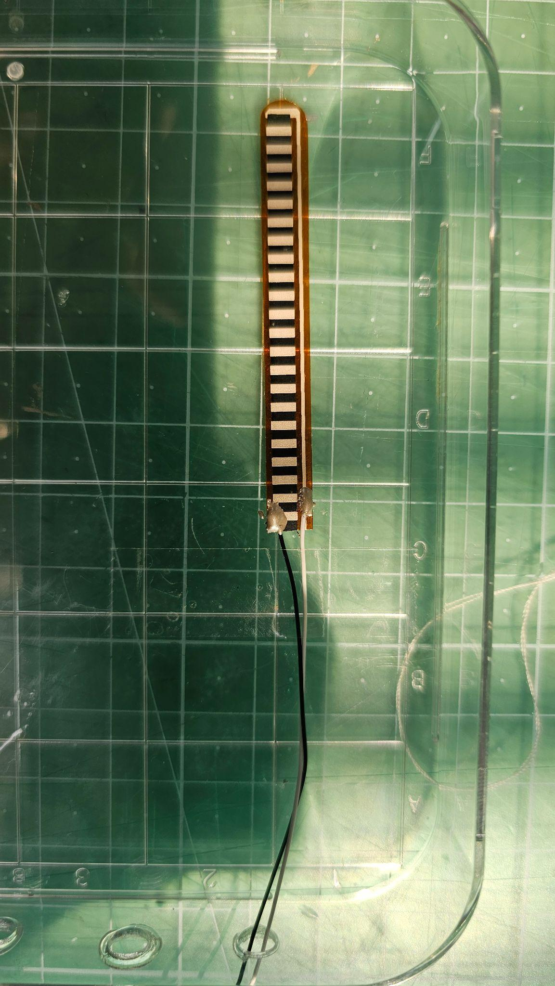
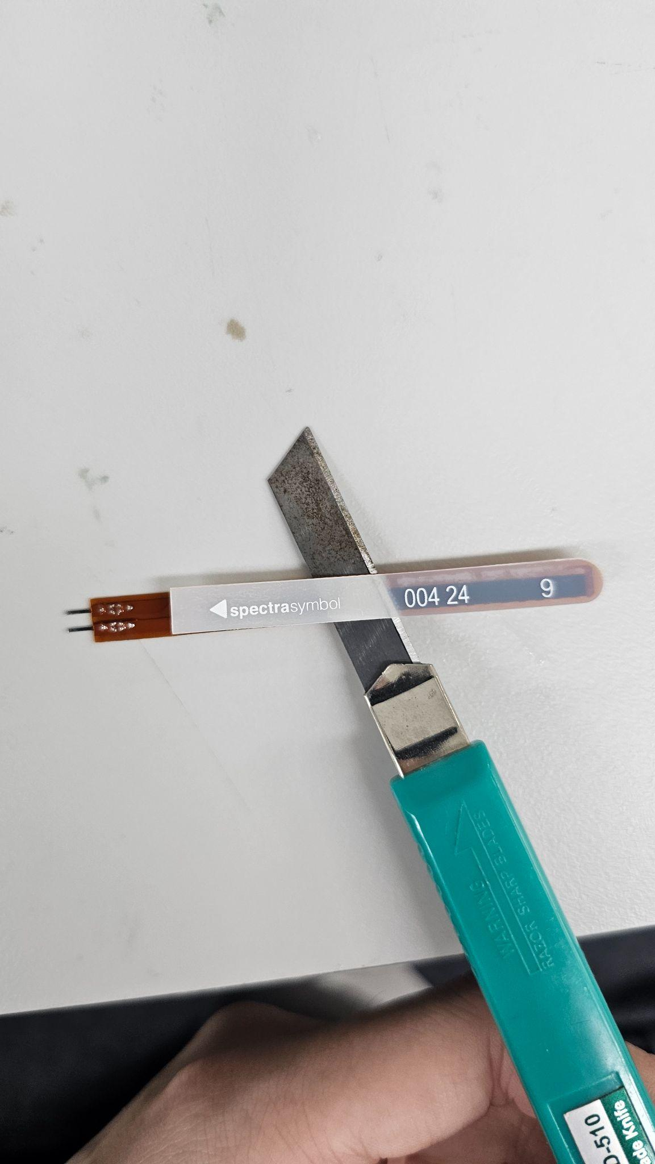
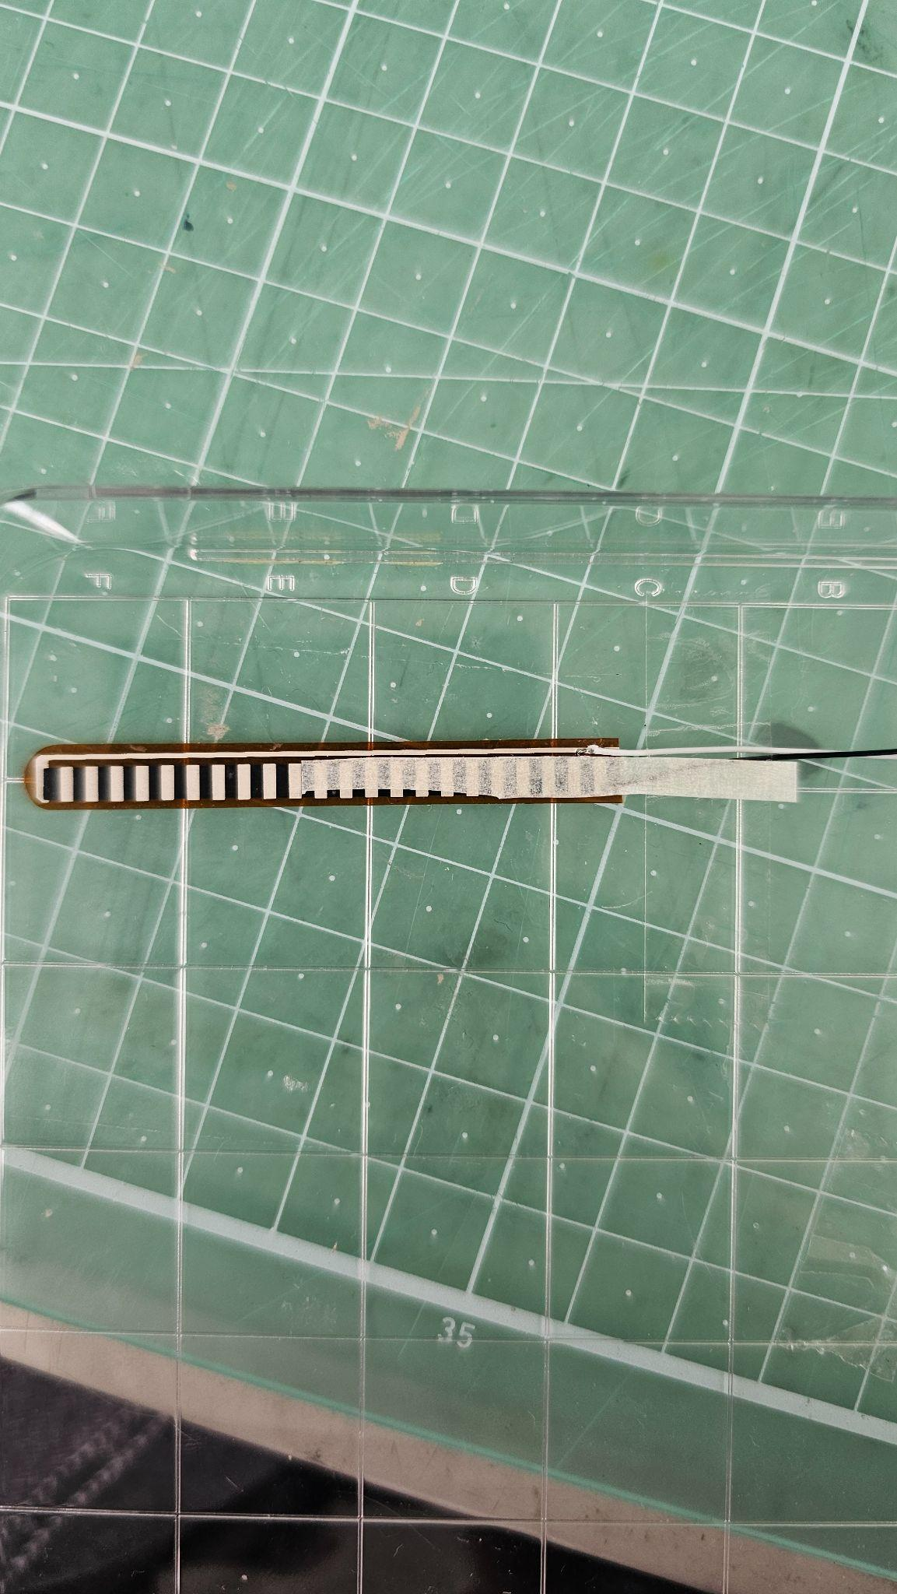
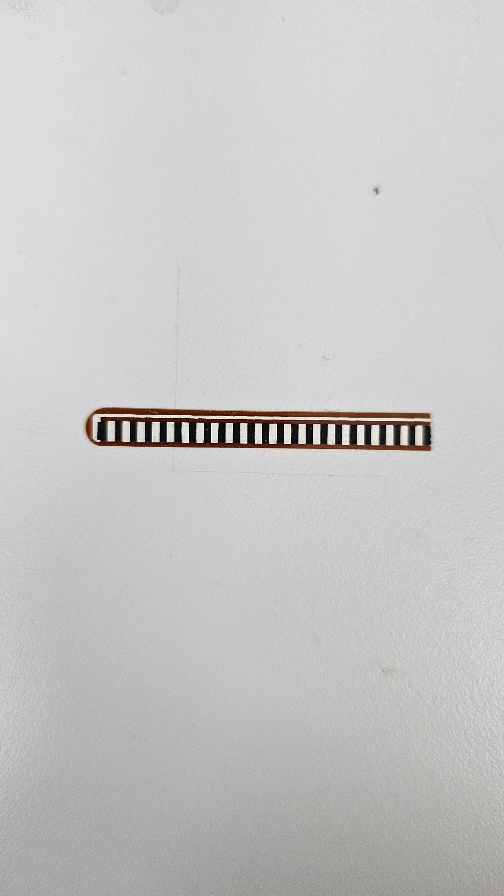
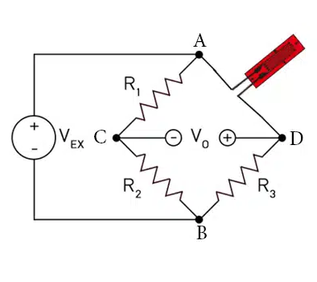
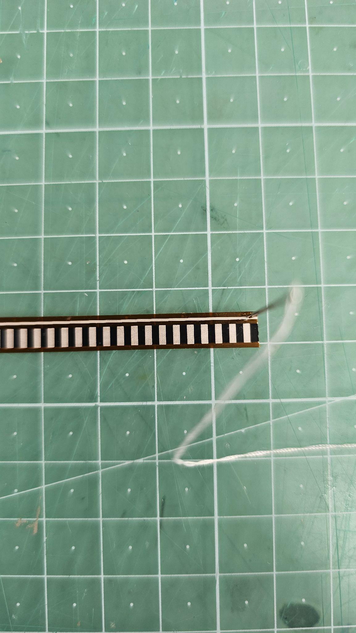
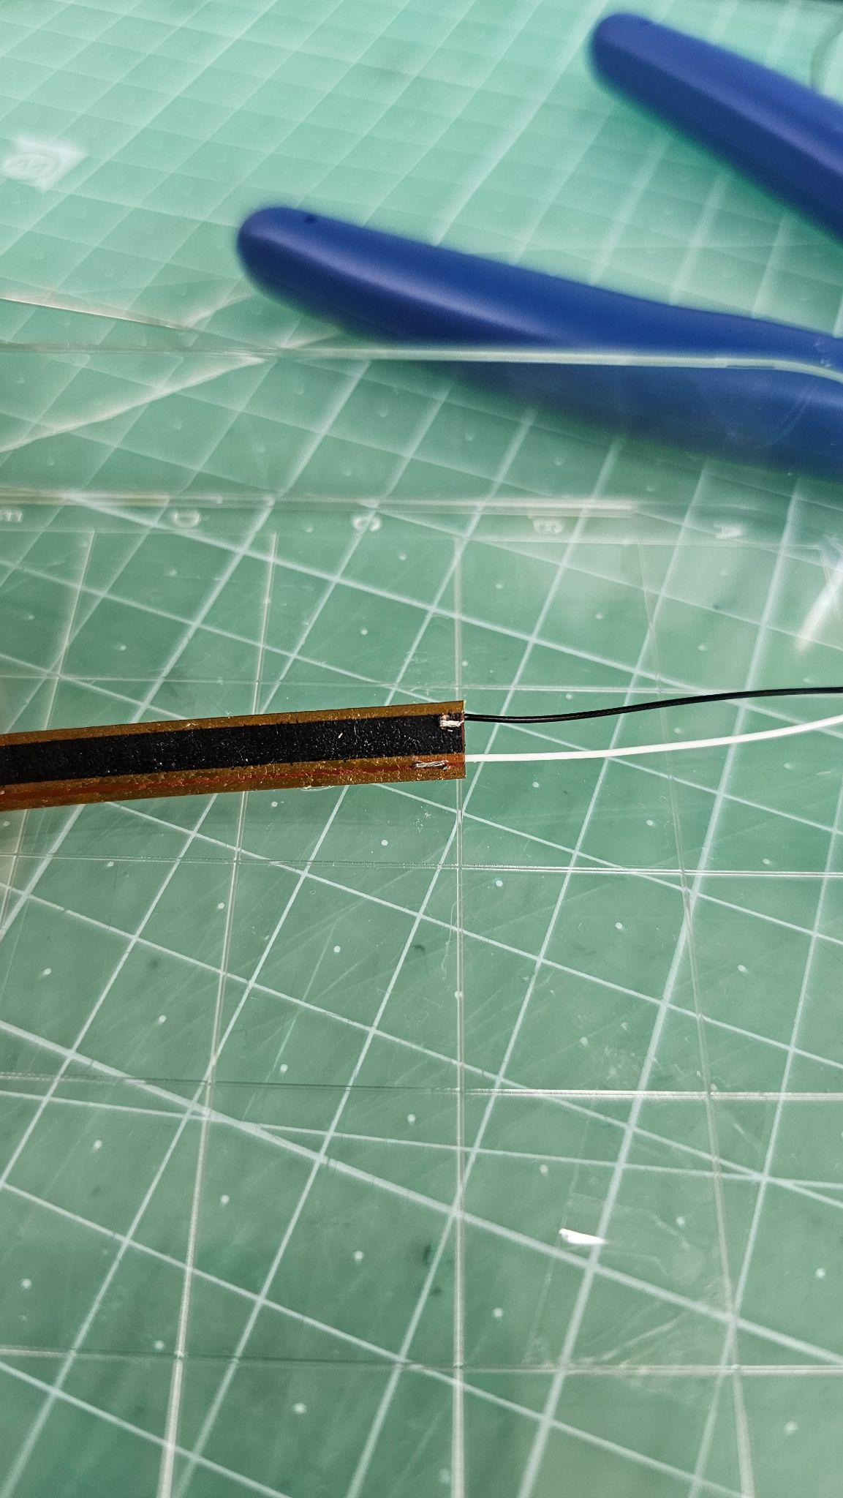
Flex Sensor
5. Put masking tape
1. Remove stiff plastic layer
6. Apply conducting epoxy
2. Cut Sensor
3. Make hole in each circuit
7. Connect to wheatstone bridge
4. Put wire through the hole
Increases resistance when deformed

Slide 10
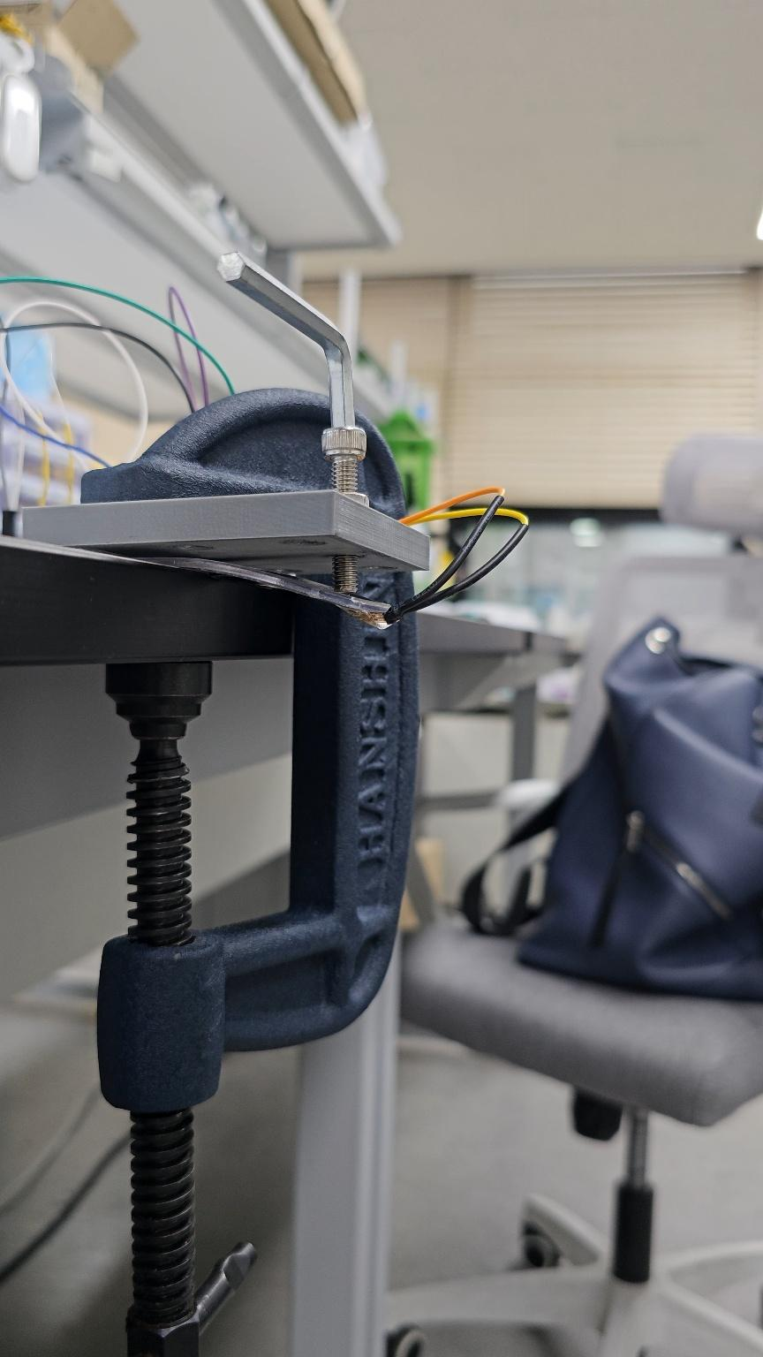
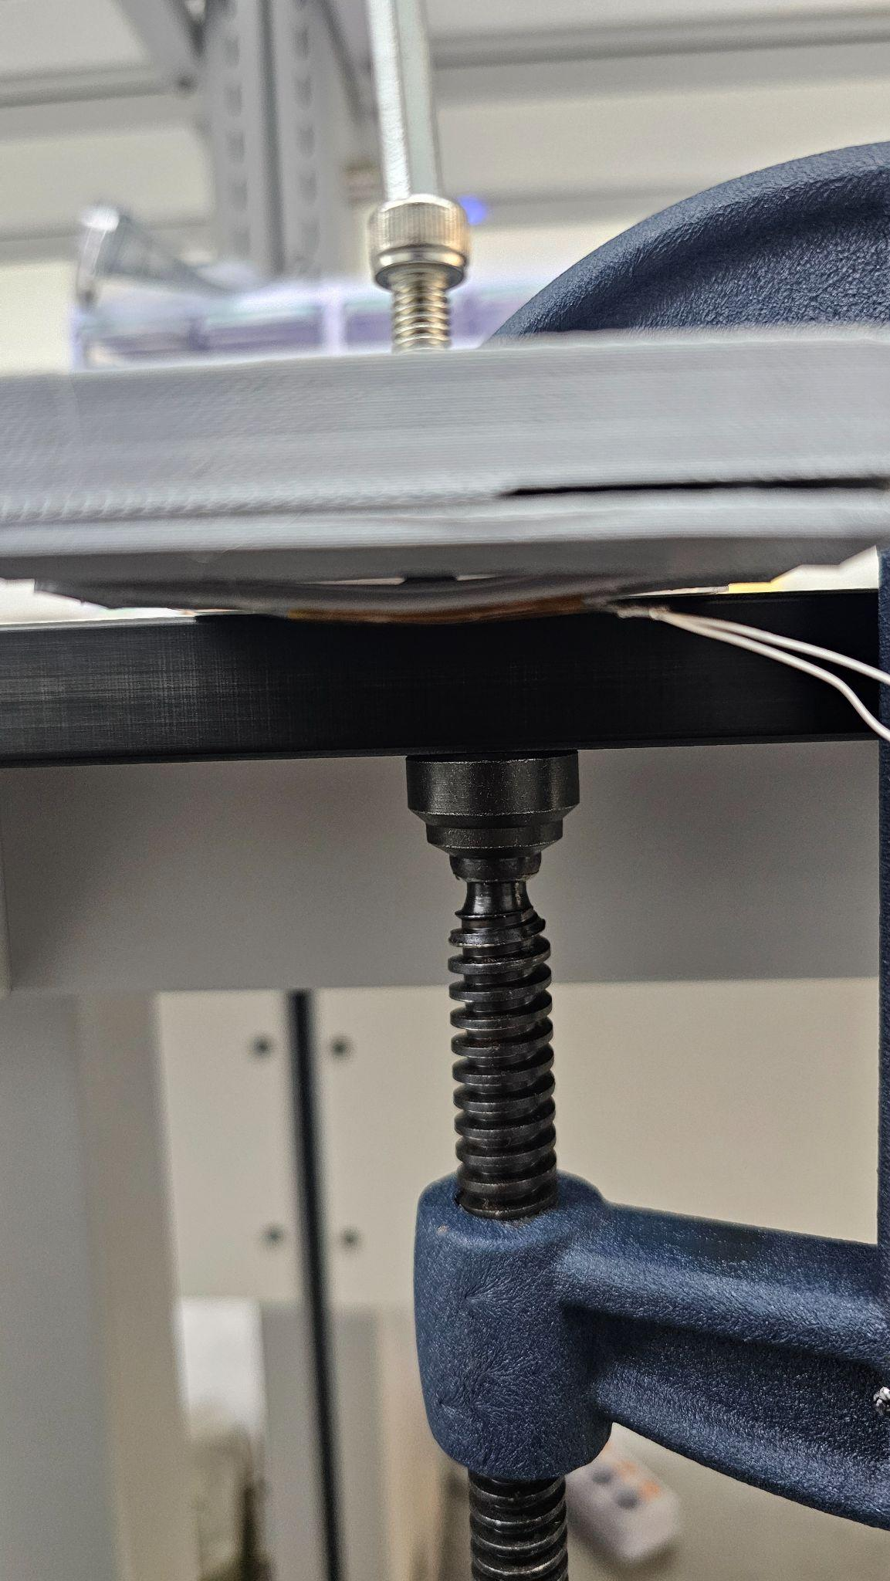
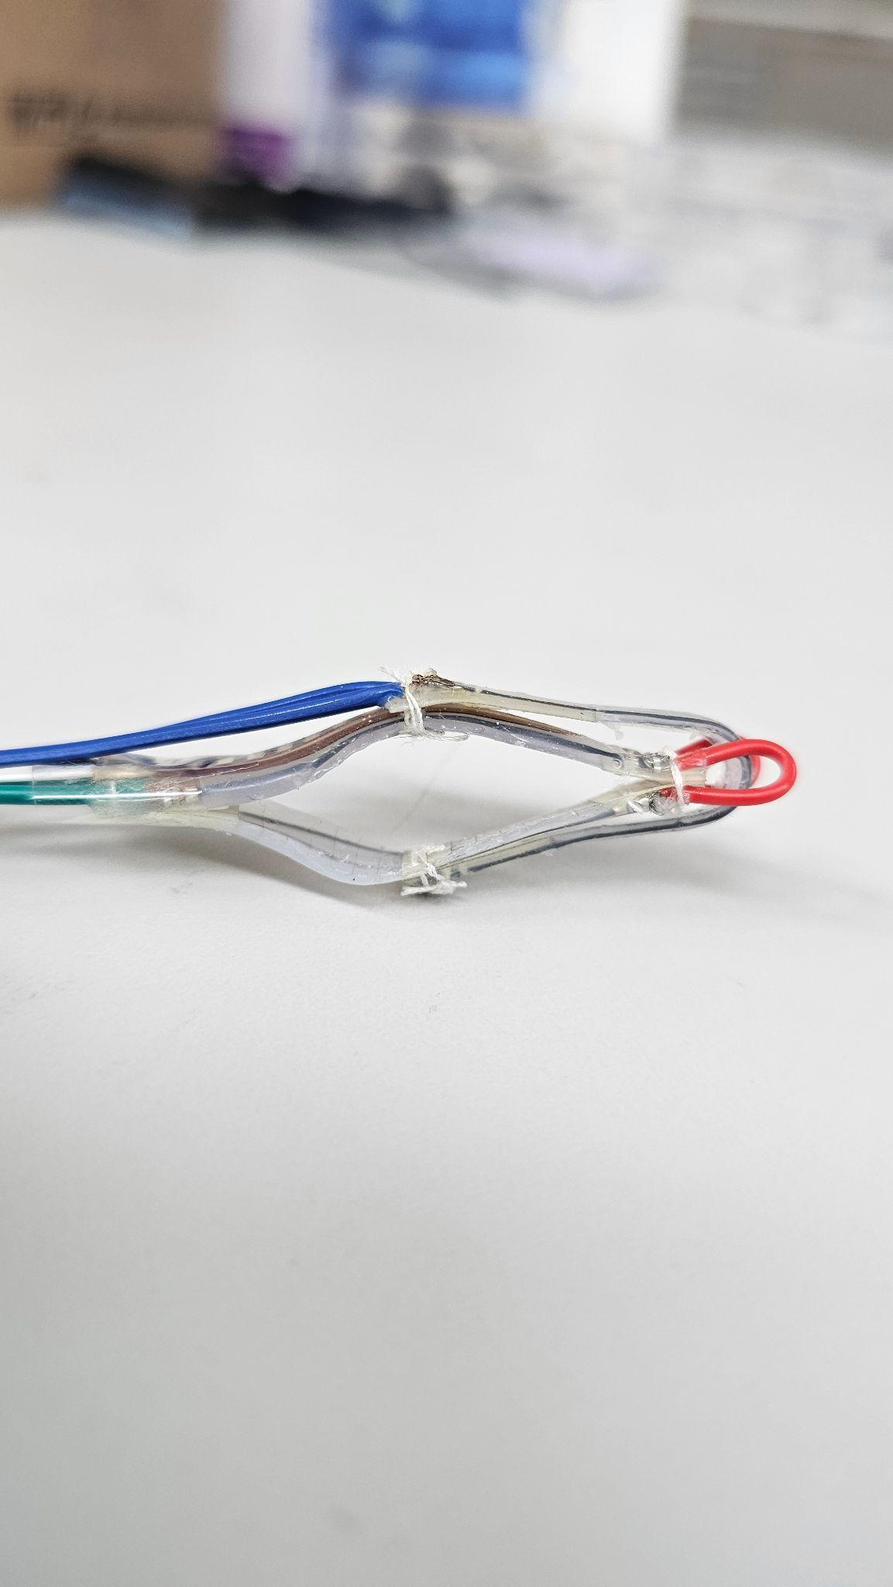
Fixed Deflection Test
Figure 1: Fixed deflection test V1
Figure 2: Fixed deflection test V2
Figure 3: Intended deformation of test V1
Figure 4: Intended deformation of test V2

Slide 11
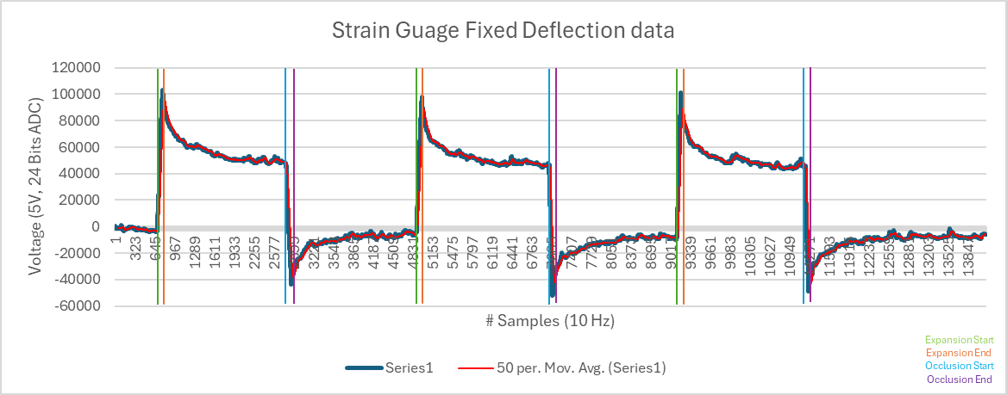
Fixed Deflection Test Results - Strain Gauge
Distinguishable, consistent states
Large overshoot and undershoot
Fluctuations and noise

Slide 12
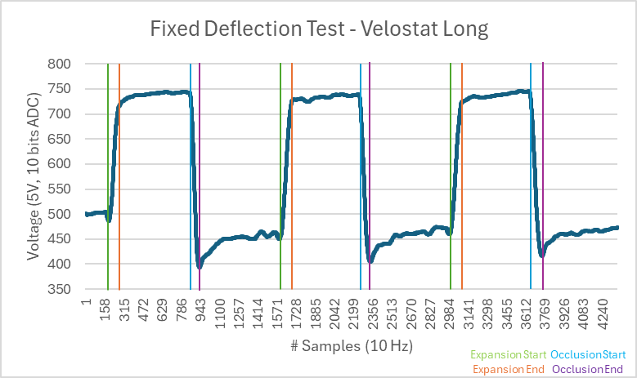
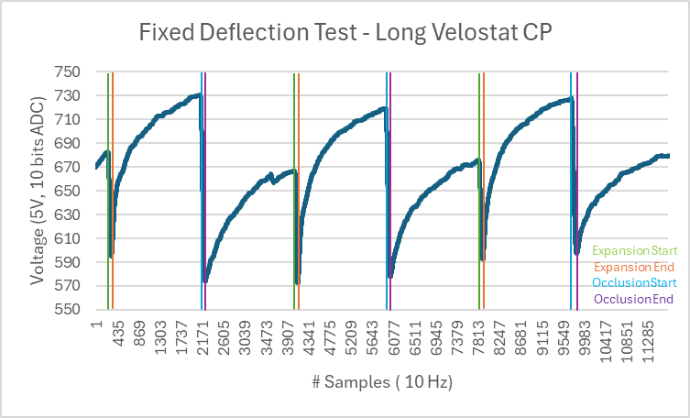
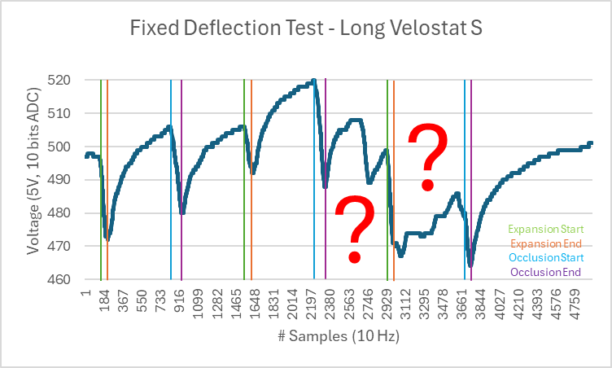

Fixed Deflection Test - Velostat
Kapton tape
Distinguishable, consistent states
Large undershoot
Fluctuations and noise
Conducting Proxy
Distinguishable states?
Unexpected pattern
Silicon Casted
Indistinguishable states
Huge fluctuations

Slide 13
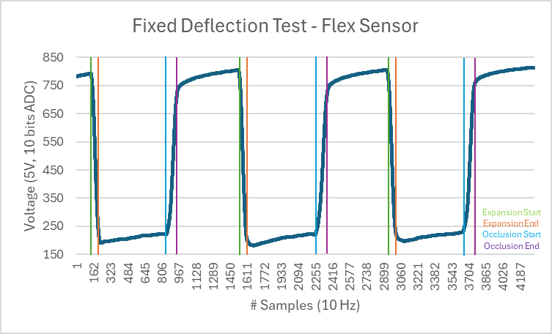
Fixed Deflection Test - Flex Sensor
Distinguishable, consistent states
No significant undershoot or overshoot
Minimal fluctuations and noise
Stabilization time delay

Slide 14

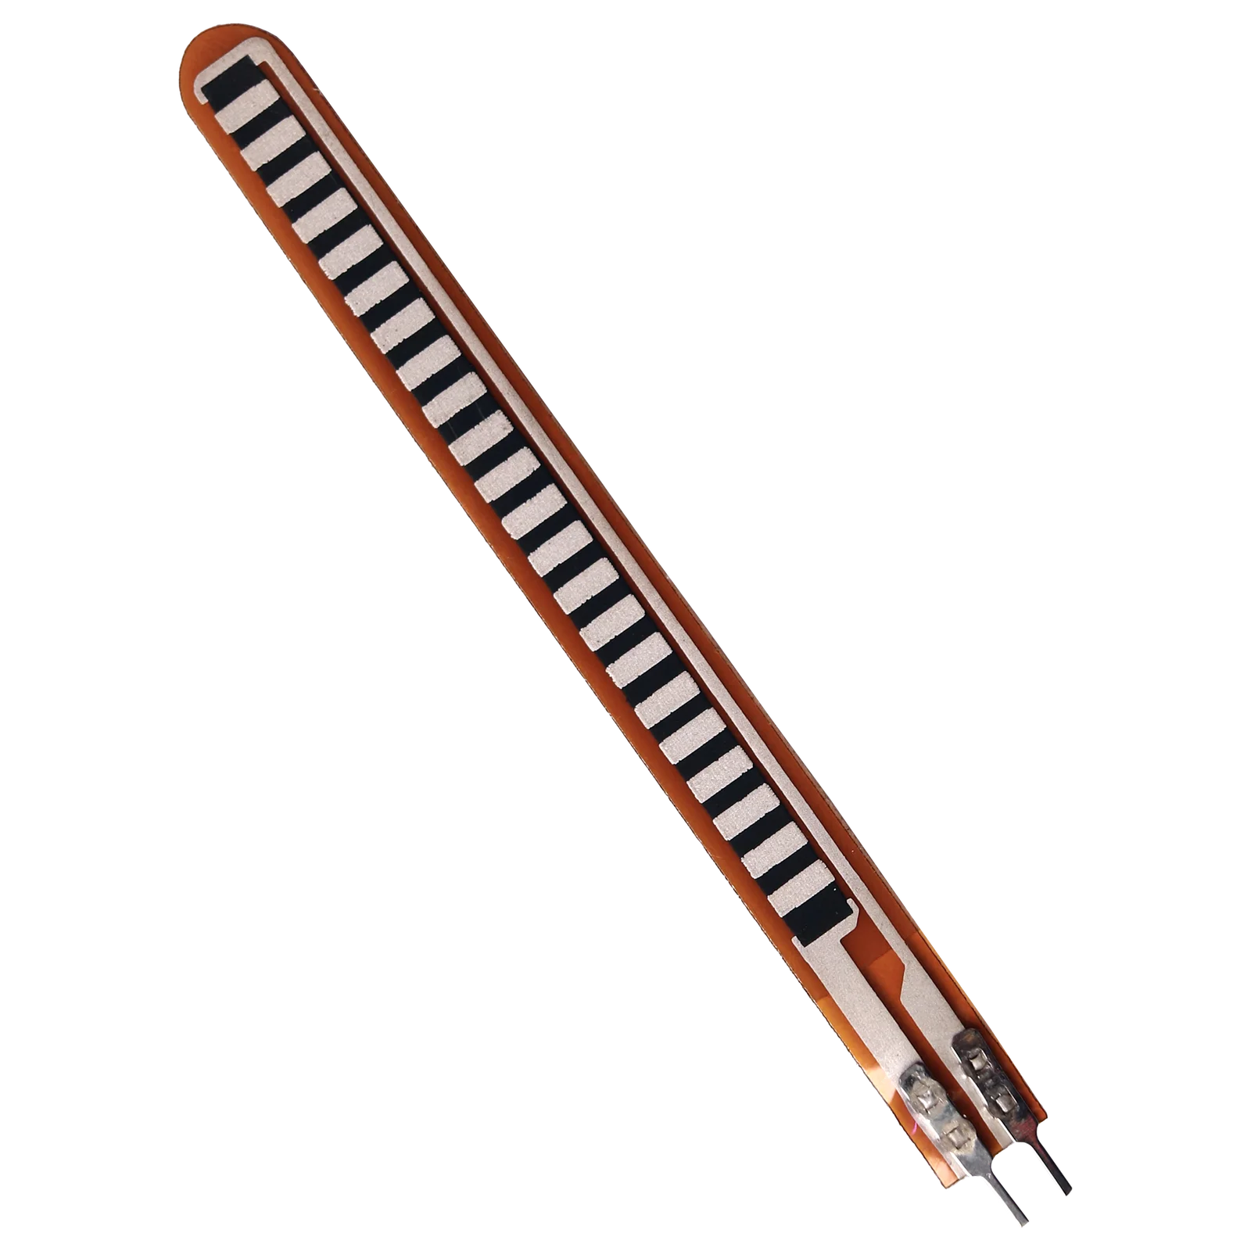
Fixed Deflection Test - Flex Sensor
Distinguishable, consistent States
No significant undershoot or overshoot
Minimal fluctuations and noise
Stabilization time delay
Figure 1: Flex sensor got caught!

Slide 15
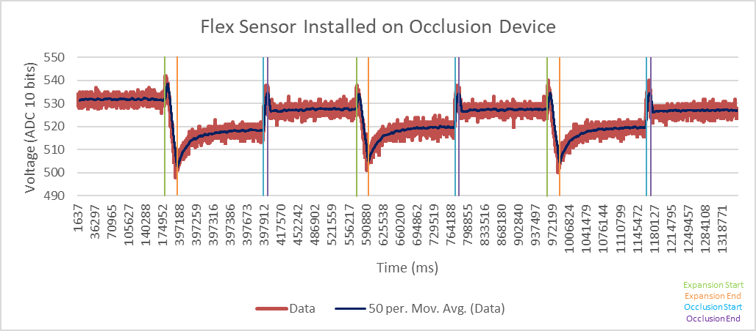
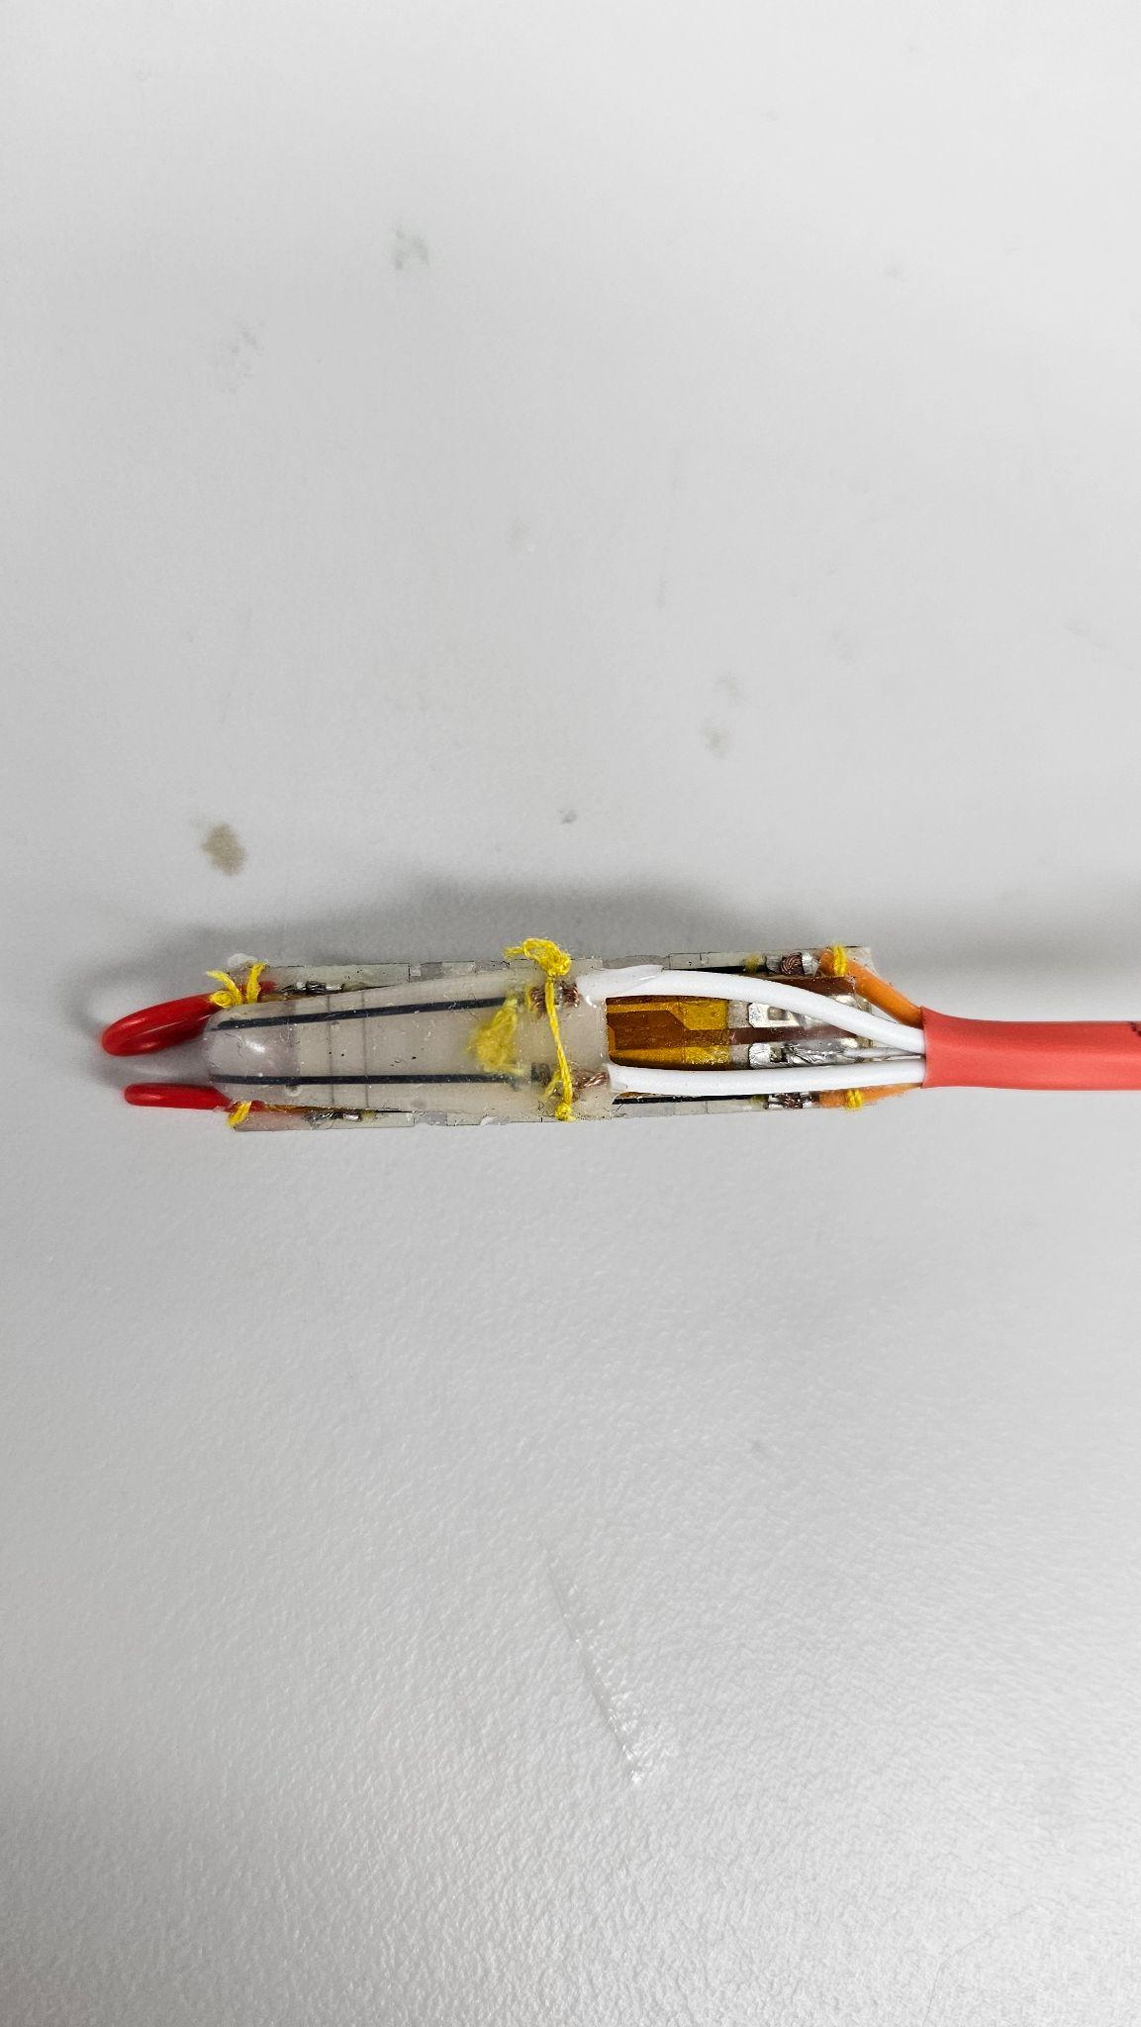
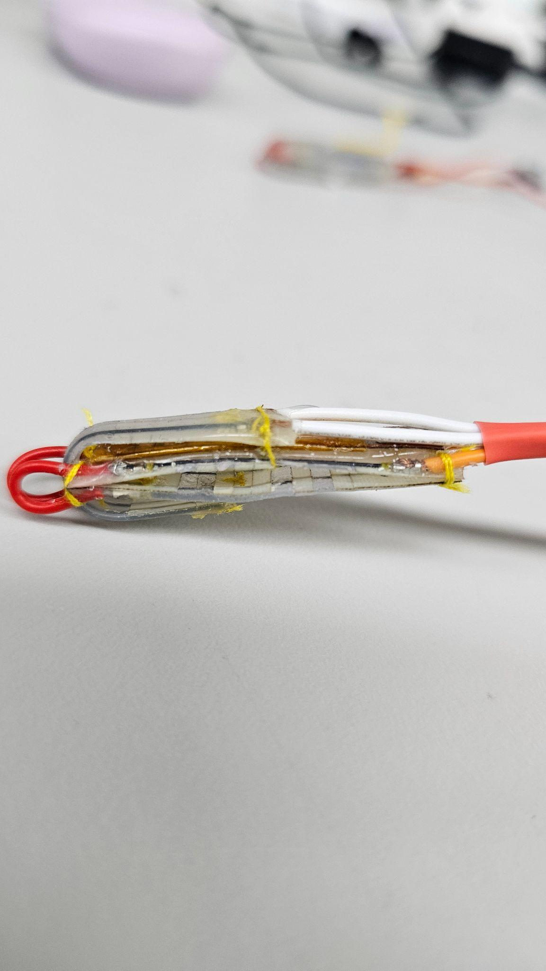
Device Integration - Flex Sensor V1
Figure 1: Flex Sensor V1 installation
Data at initial state > data after expansion
Distinguishable, consistent states
Flex sensor stiffness hindering expansion
Tendency to occlude back when expanded

Slide 16
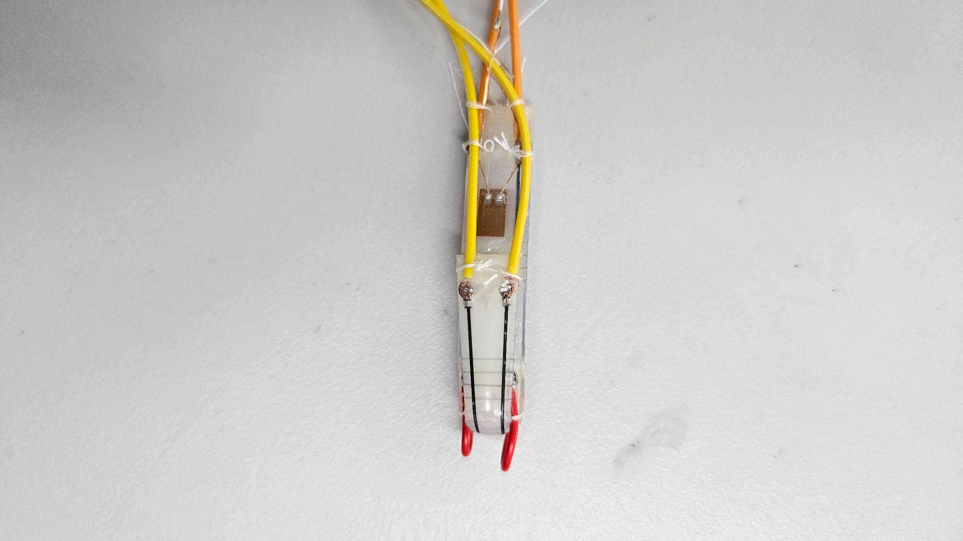
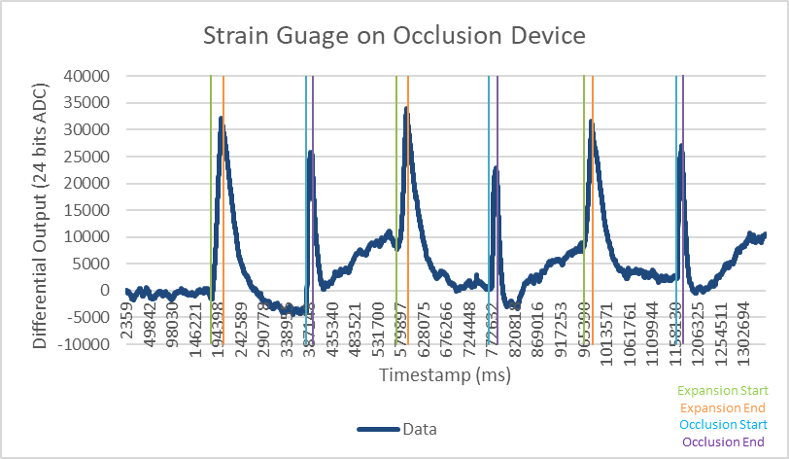
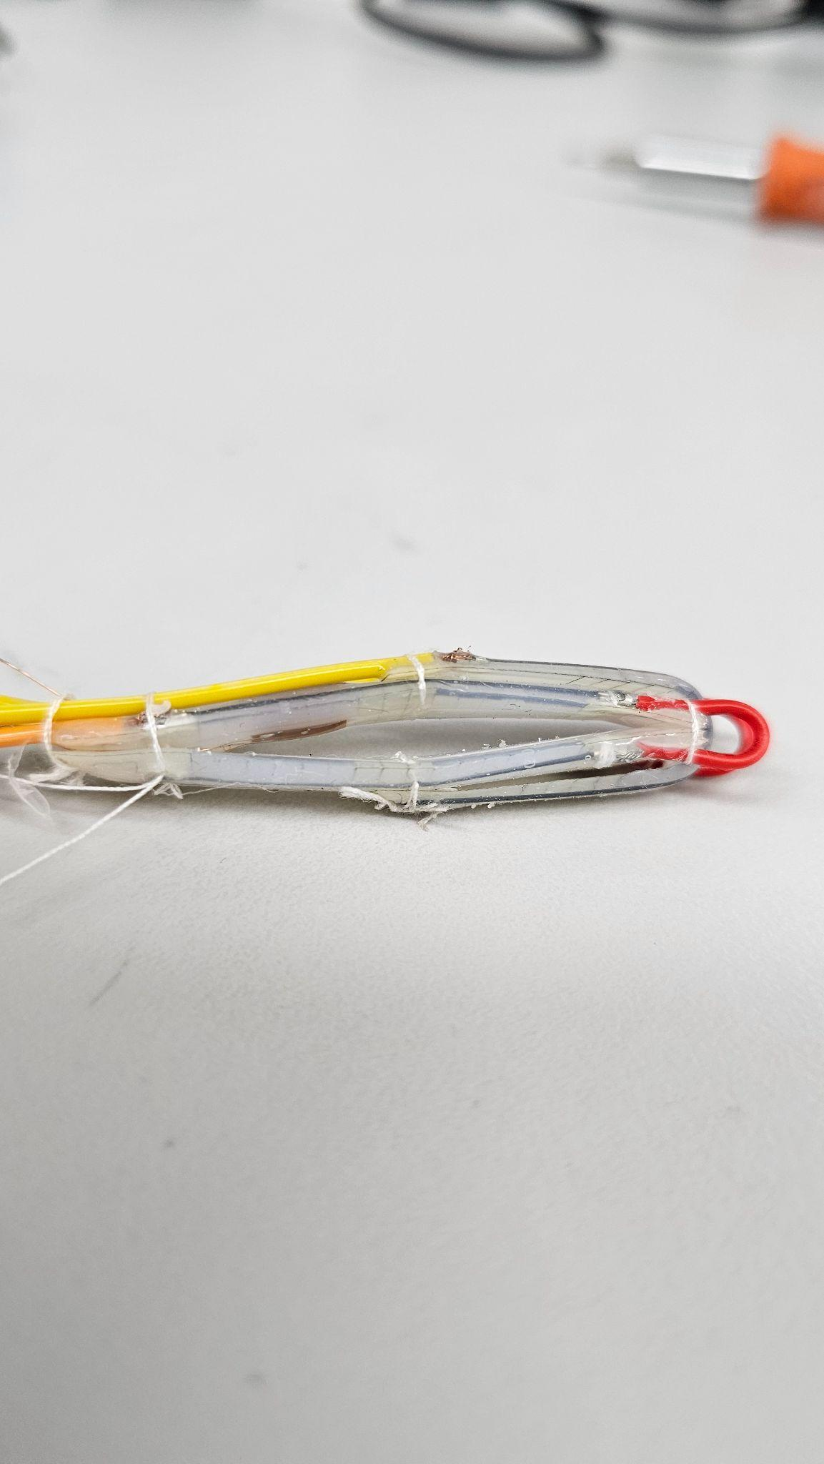
Device Integration - Strain Gauge
Figure 1: Strain gauge installation
Indistinguishable, inconsistent states
Unexpected pattern

Slide 17
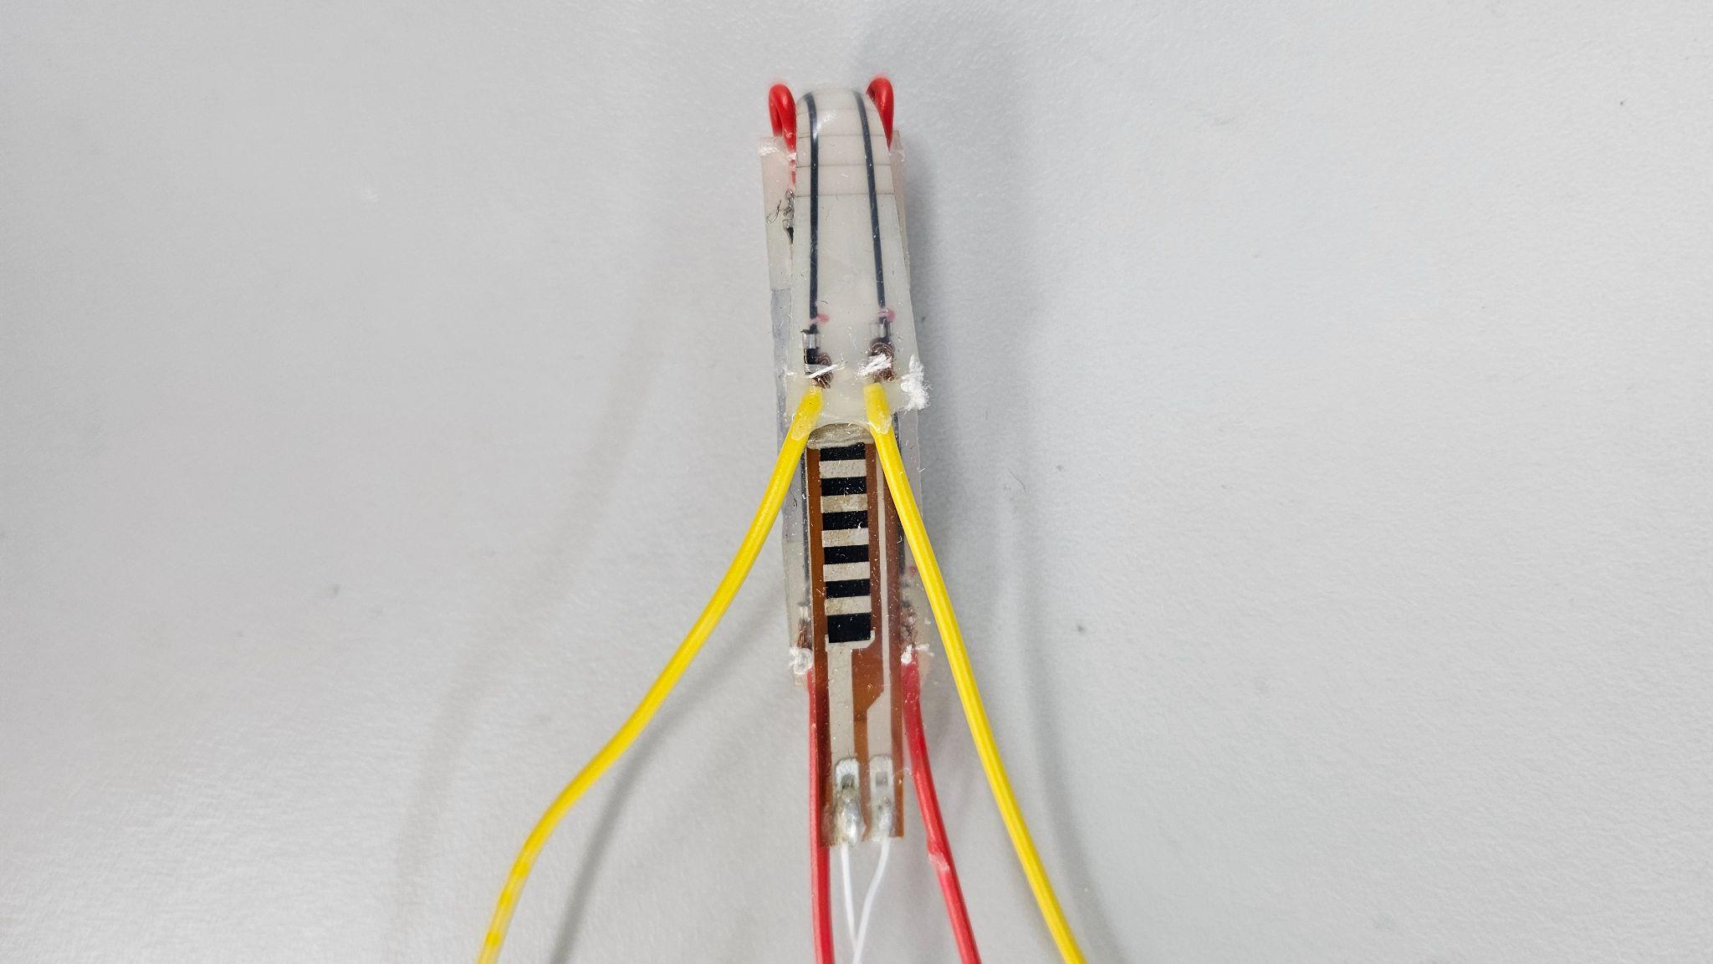
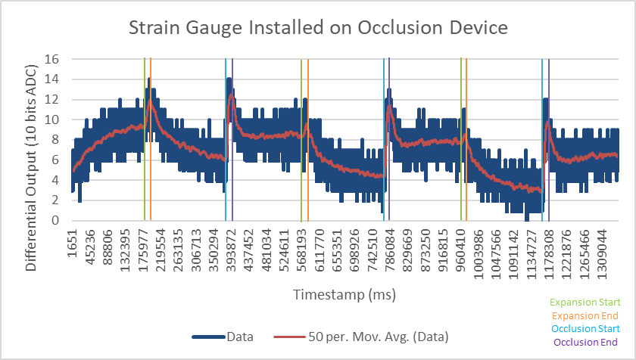
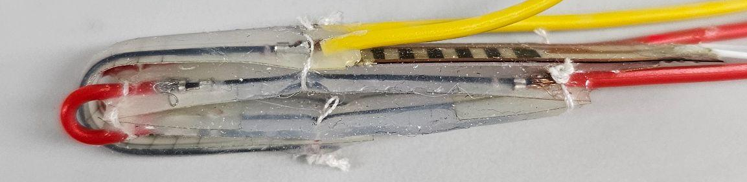
Device Integration - Flex Sensor V2
Figure 1: Flex sensor V2 installation
Sensor insensitive to state change
Distinguishable, but inconsistent values at each states

Slide 18
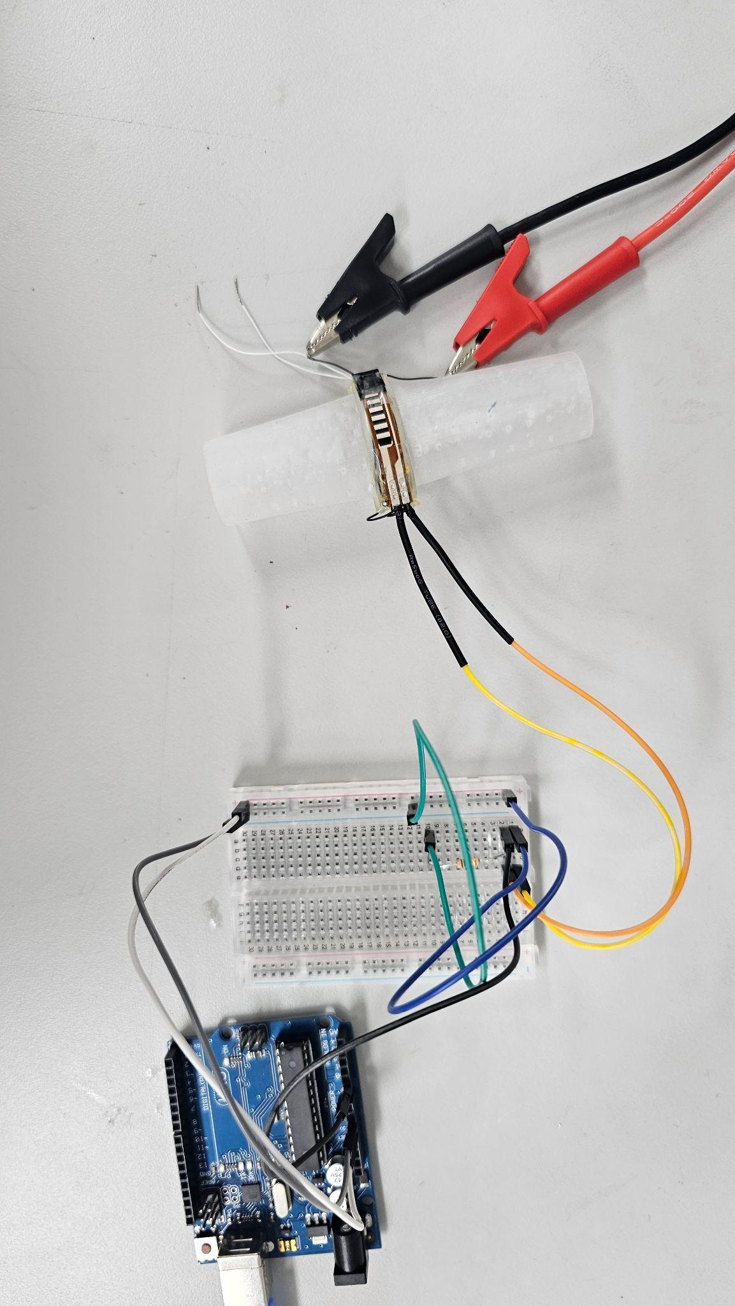
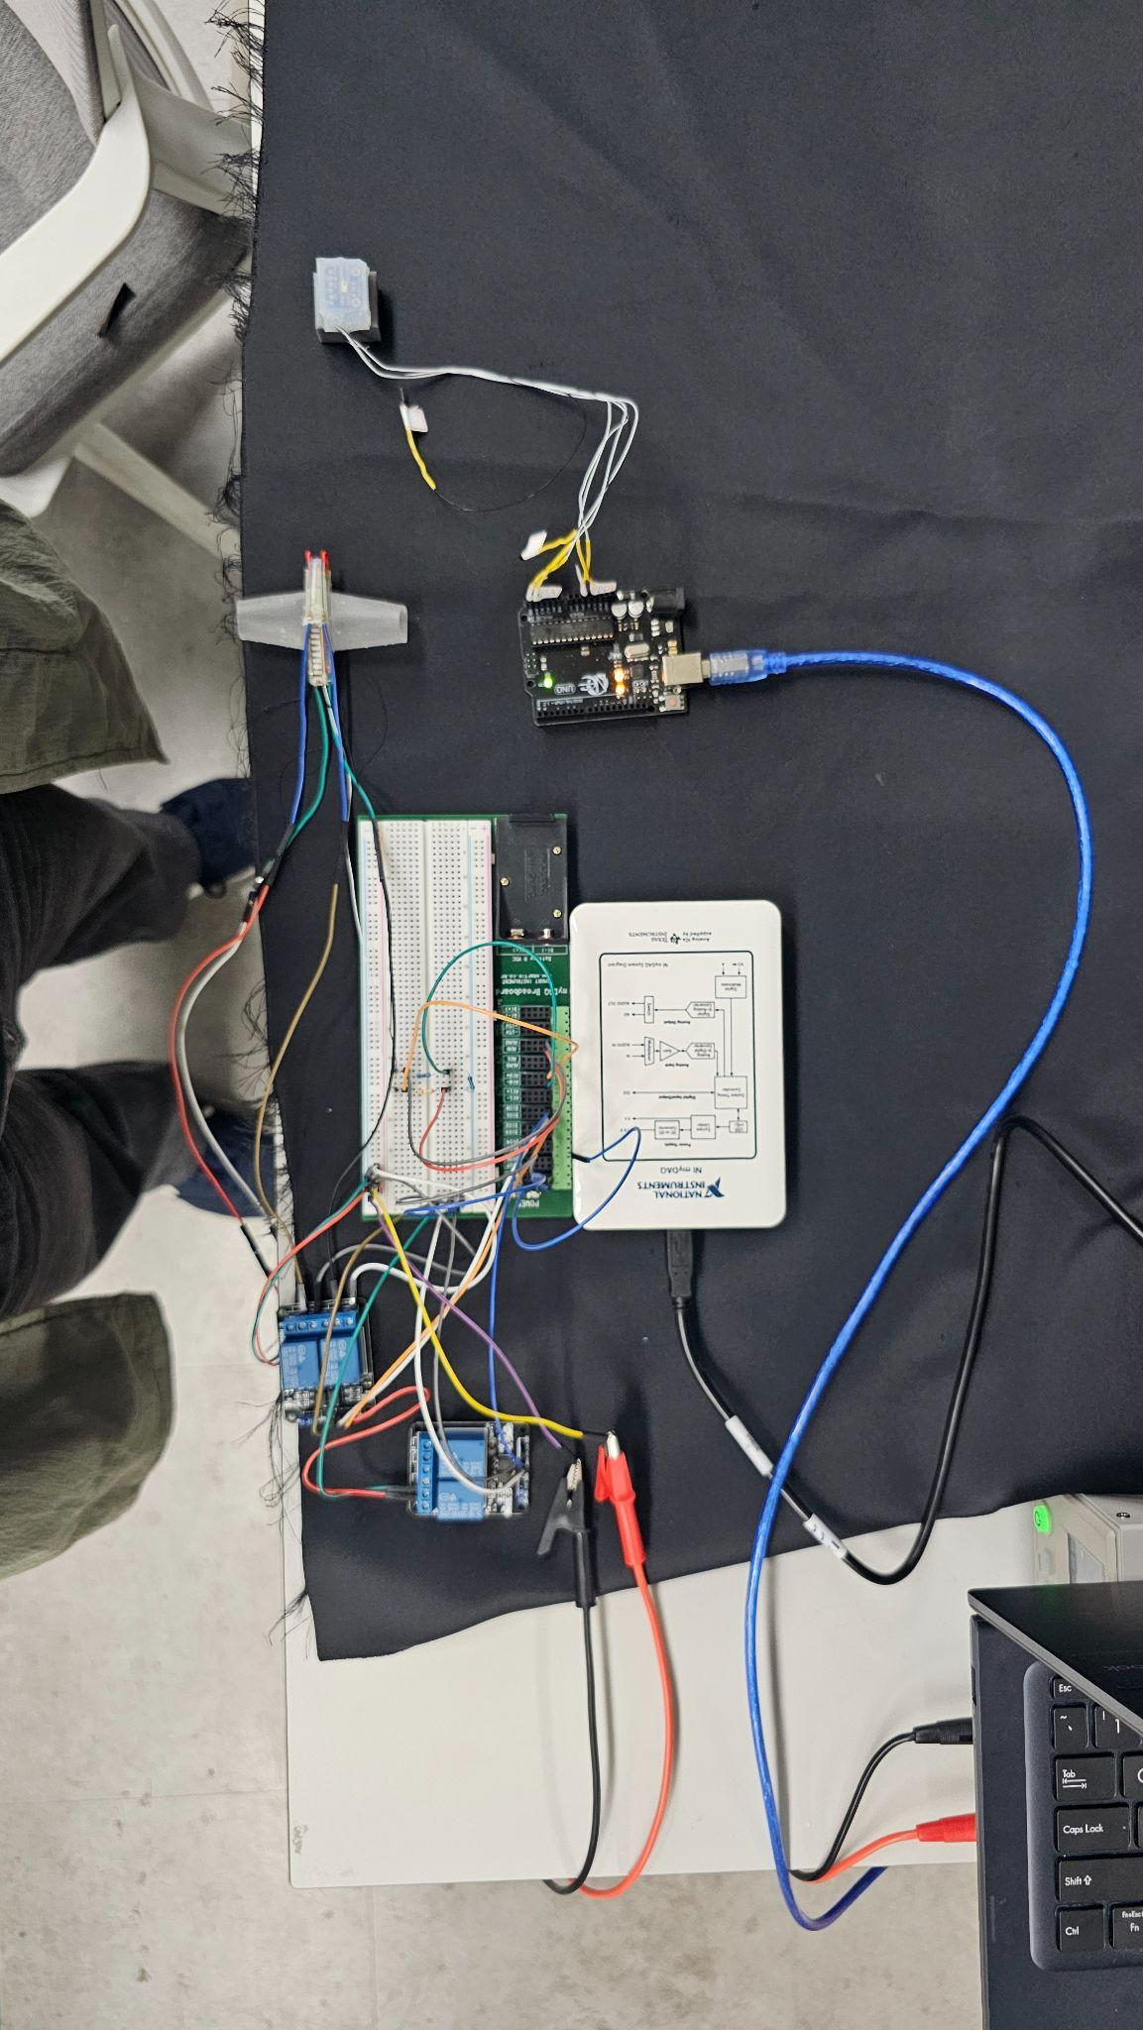

Data Acquisition System
Greater data collection resolution and sampling rate
Minimal output fluctuations
No common ground voltage fluctuations
Greater data processing expandability using matlab
Figure 1: Circuit connection using arduino
Figure 2: Circuit connection using myDAQ

Slide 19
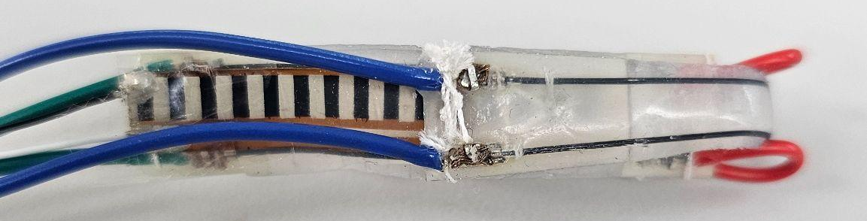
Flex Sensor V3
Removed bending-insensitive region and stiff plastic layer
Temperature effect from SMA
Significant deformation only in center
Hinder expansion, help occlusion
Figure 1: Flex Sensor V3 installation

Slide 20
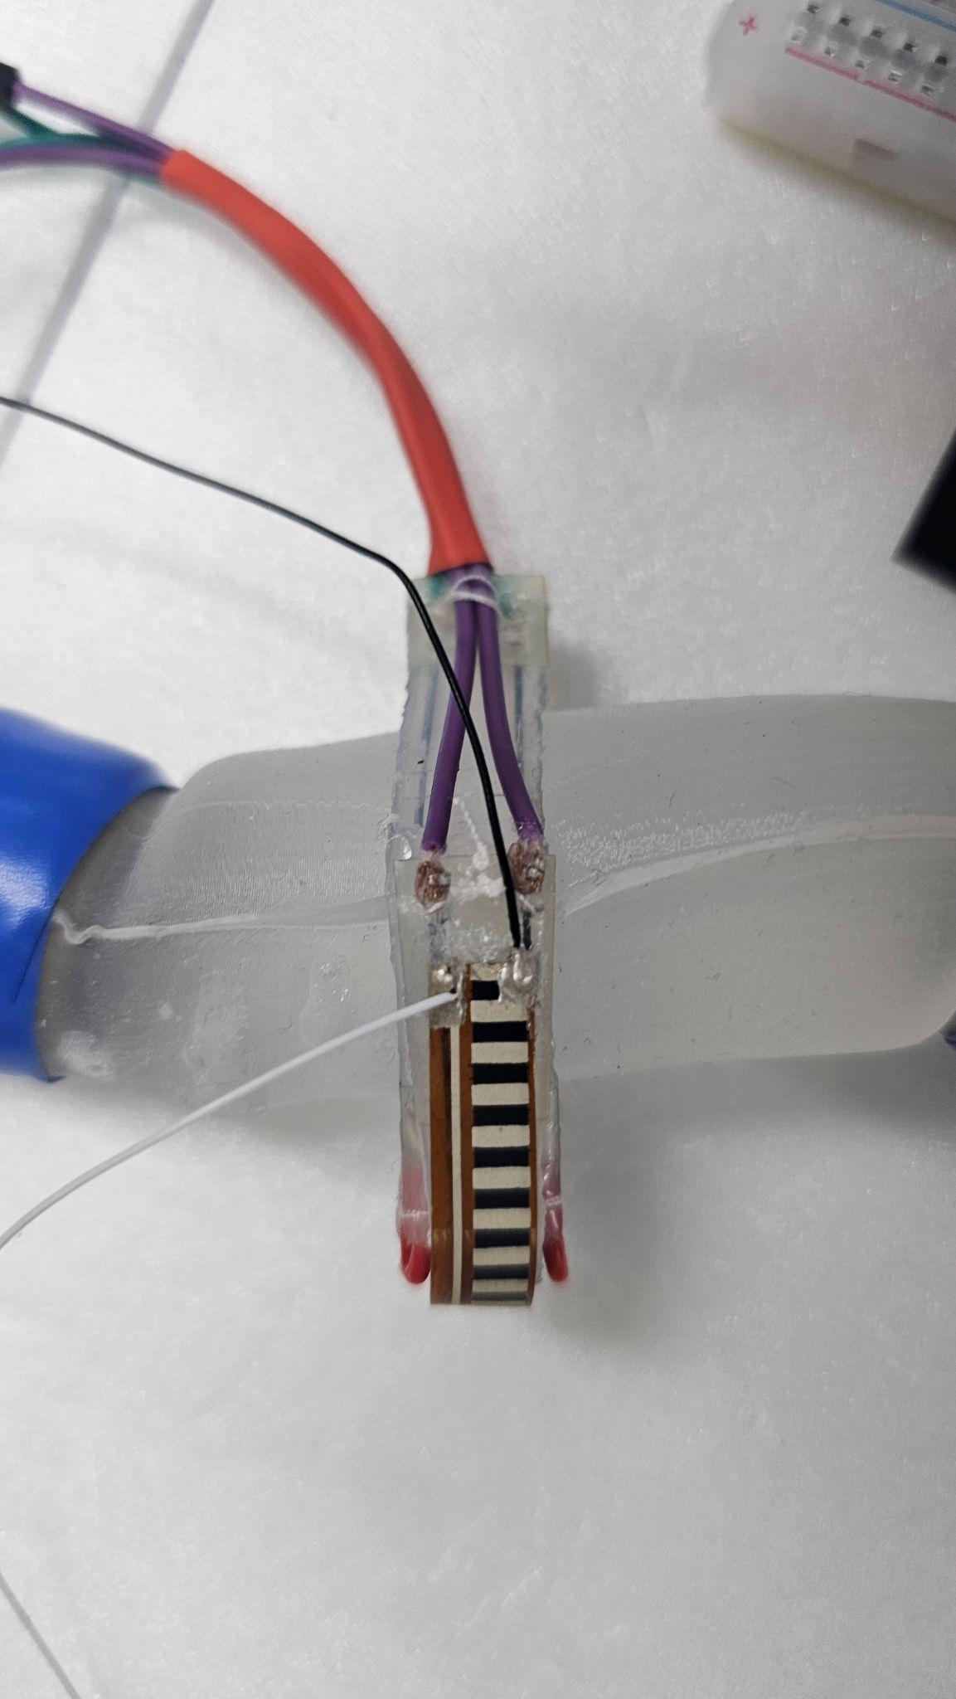
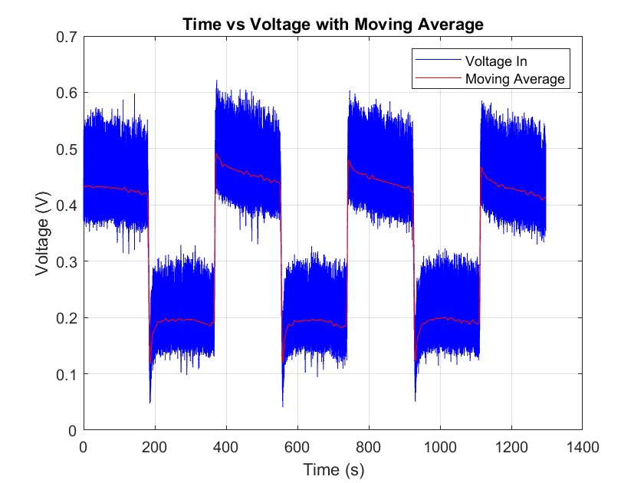
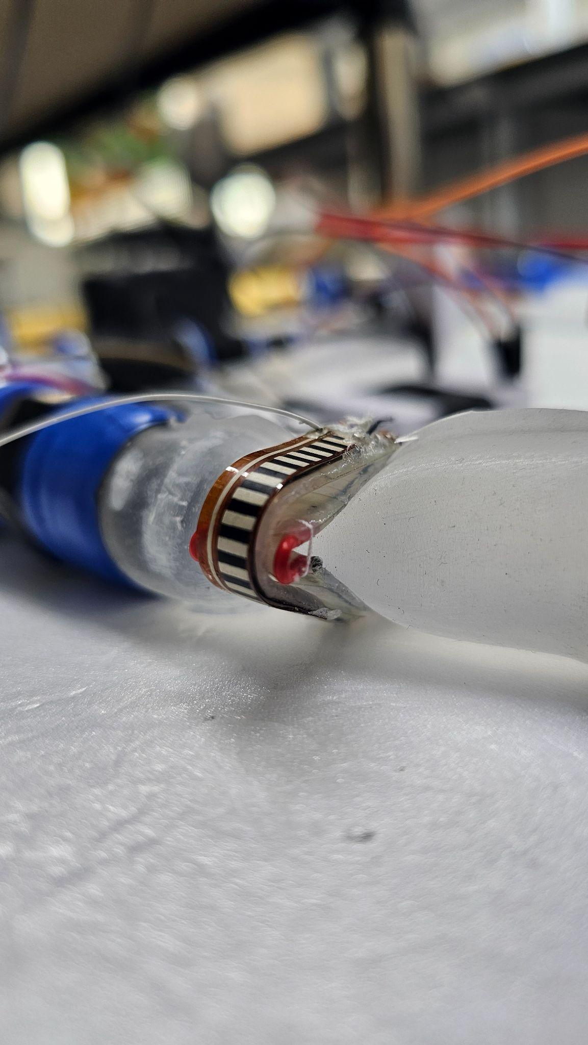
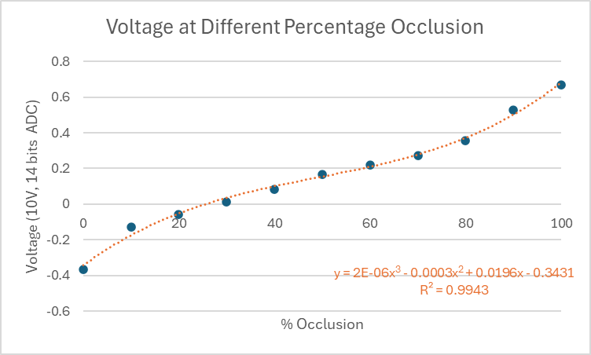
Flex Sensor V4
Distinguishable, Consistent states
Figure 1: Flex Sensor V4 installation
Sensor not casted in silicon
Less temperature effect from SMA
More accurately reflect device actuation status
Hinder occlusion, help expansion
3rd order polynomial-like shape

Slide 21
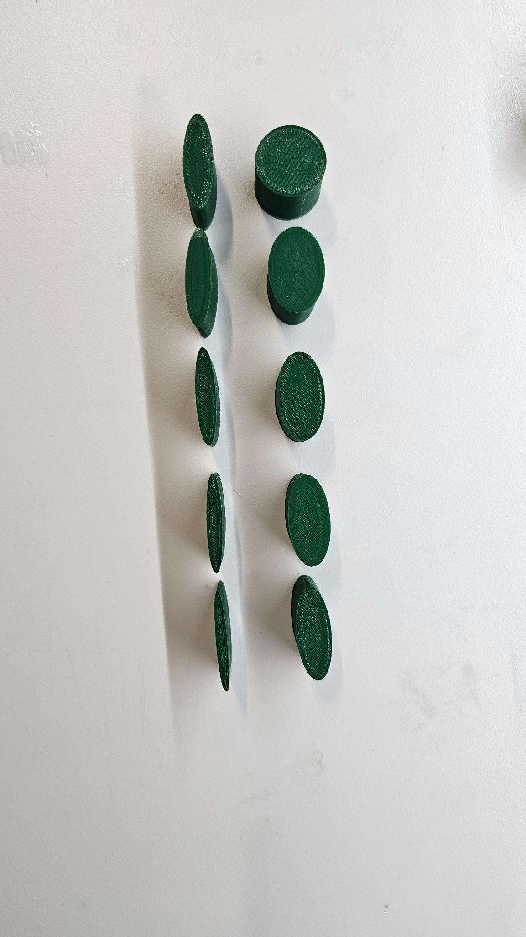
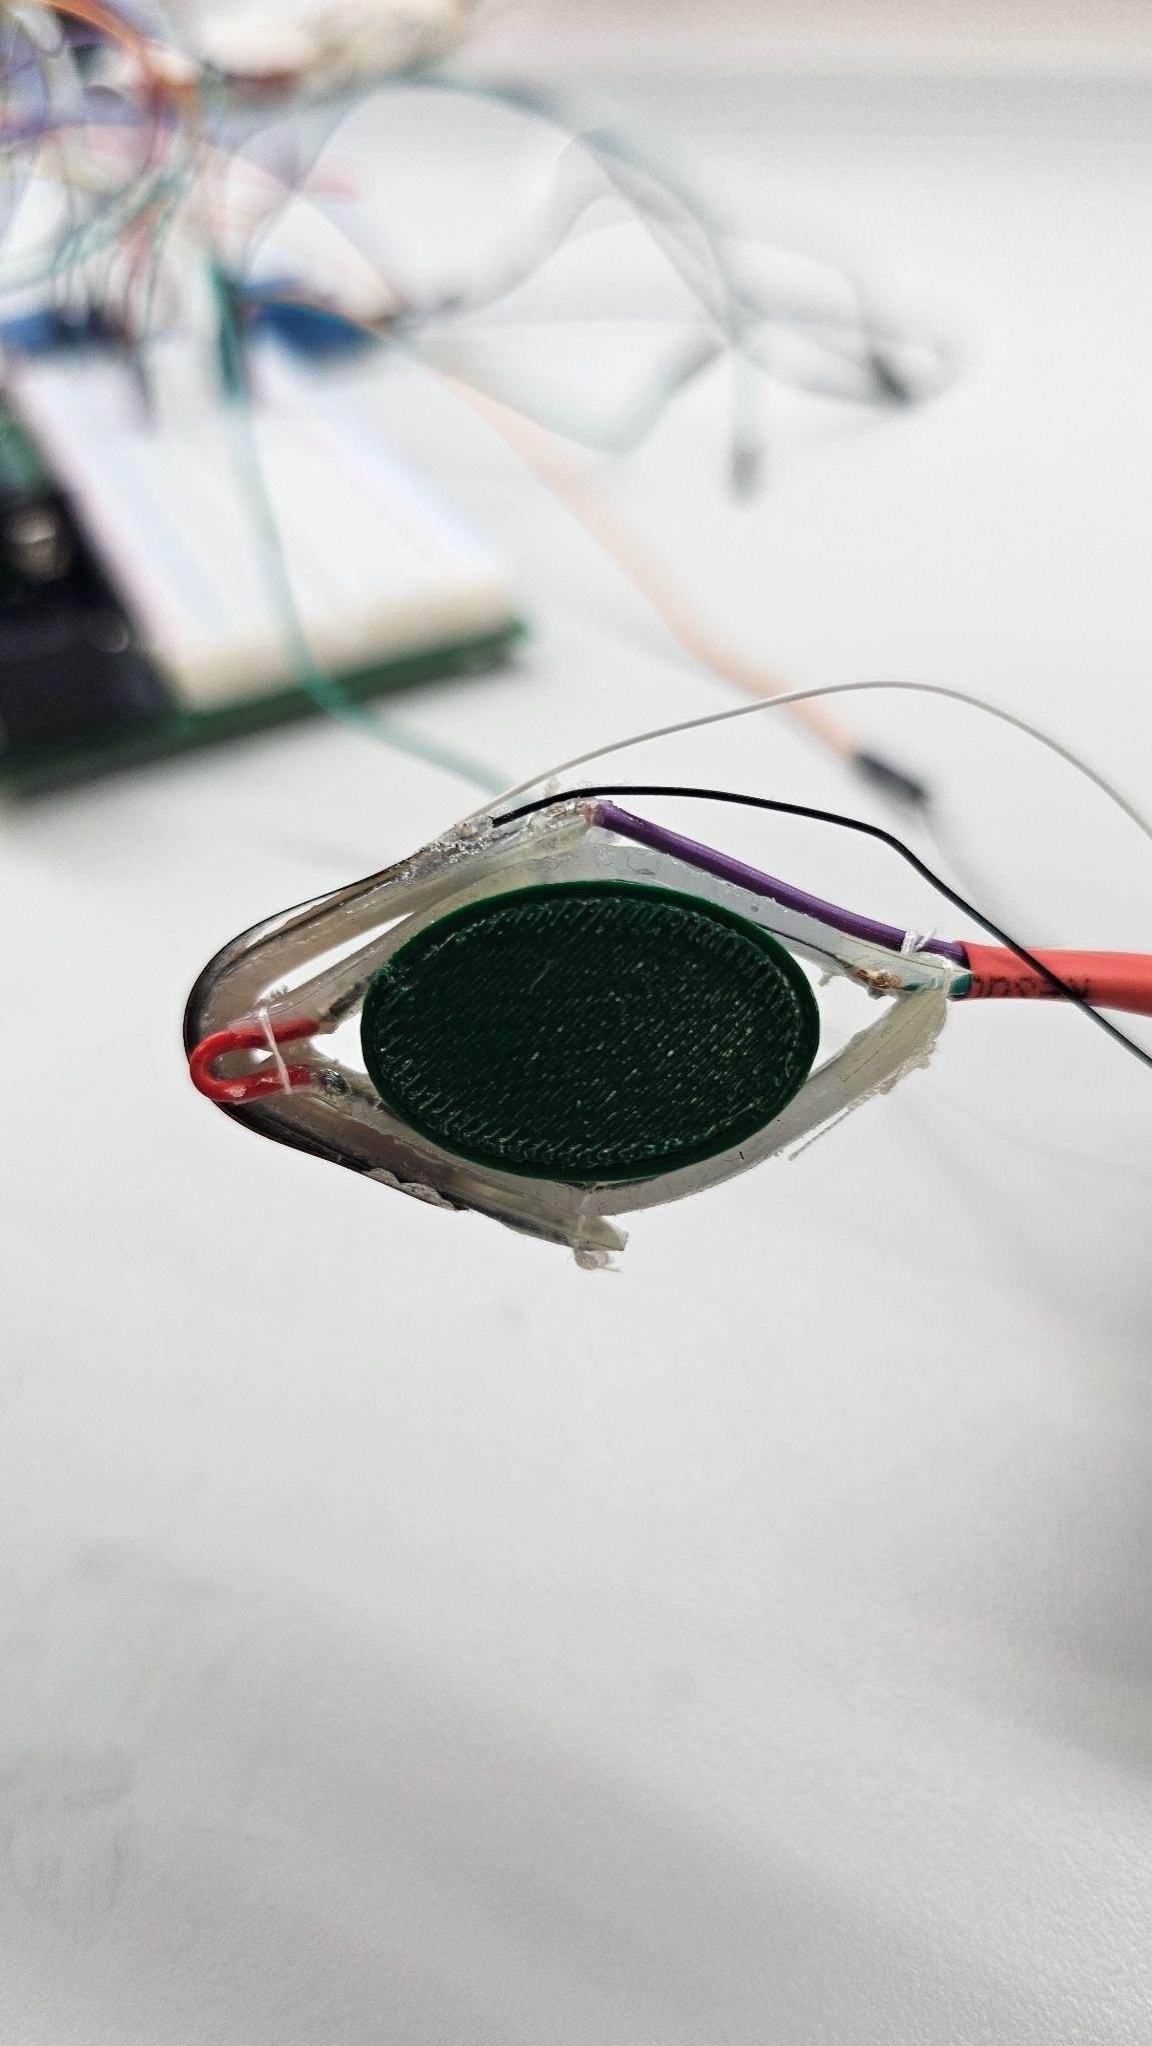
Obtaining Voltage at different % Occlusion
Figure 1: Rigid SVC printed based on % occlusion
Figure 2: Rigid SVC equipped on the device

Slide 22
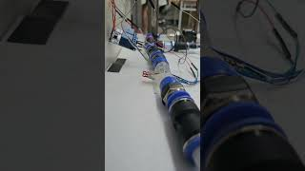
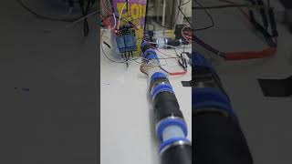
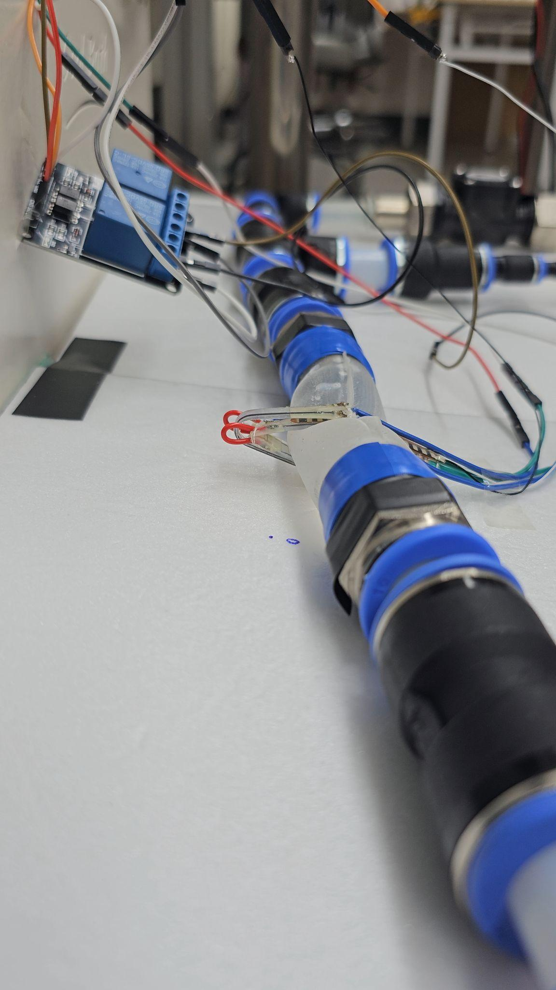

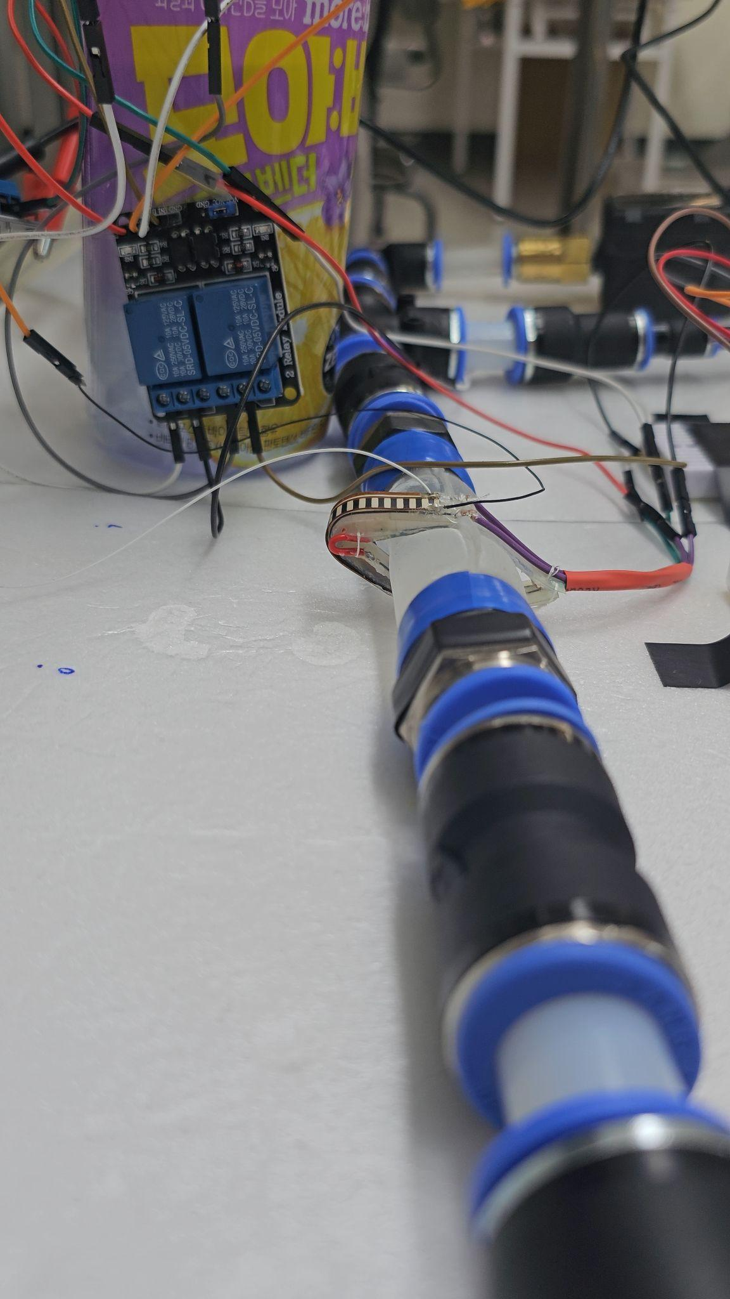




Percentage Occlusion Control

Slide 23






Barometric Sensor
Figure 1: Barometric sensor cast design
Figure 2: Printed barometric sensor cast
Figure 3: Casted barometric sensor and pressure ring
eVAC used casted barometric sensor to sense intravascular pressure
Pressure ring with snap fit casted barometric sensor to install on SVC and obtain CVP
Pirozzi, I., Kight, A., Liang, X., Han, A. K., Ennis, D. B., Hiesinger, W., Dual, S. A., & Cutkosky, M. R. (2022). Electrohydraulic Vascular Compression Device (e‐VaC) with Integrated Sensing and Controls. In Advanced Materials Technologies (Vol. 8, Issue 4). Wiley. https://doi.org/10.1002/admt.202201196

Slide 24


Fixed Mass Test
Figure 1: Fixed mass test

Slide 25

Fixed Mass Test
Figure 1: Fixed mass test
Inconsistent data at same mass after heavy mass loaded
Inaccurate response to change in mass
Increasing baseline value

Slide 26



SVC Phantom Test
Figure 1: Pressure ring top view
Inconsistent data at same water pressure after high pressure applied
Figure 2: Pressure ring side view

Slide 27
Discussions
Alternative flex sensor placement to minimize hindrance to actuation and better represent actuation status of device
Resolving inconsistent data obtained from barometric sensor
Replacing relay with other power switching components
Minimizing thermal effect on bend sensors from SMA heating

Slide 28

Thank You!

